Slide 1
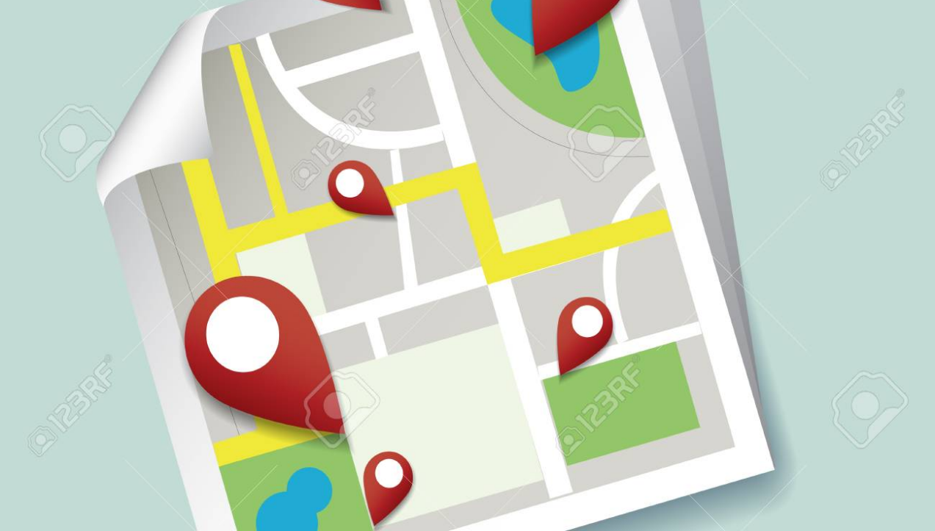
Take a few minutes with a partner to check in…
When you were a kid, what did you want to be when you grew up?

Slide 2
Our Lutheran Lens
Lutheran schools and early childhood services are communities that recognise that God has intentionally created each person and that each person is uniquely gifted to live in relationship with God and others.

Slide 3
Our Enduring understanding
God has created us for relationships and Christian spirituality finds expression in love, service and our vocations.

Slide 4
Our key foci
We are created for relationships with God and each other. The Image of God
We experience brokenness and hurt in relationships. Saint and Sinner
We express God’s call to love as we serve others. Vocation

Slide 5
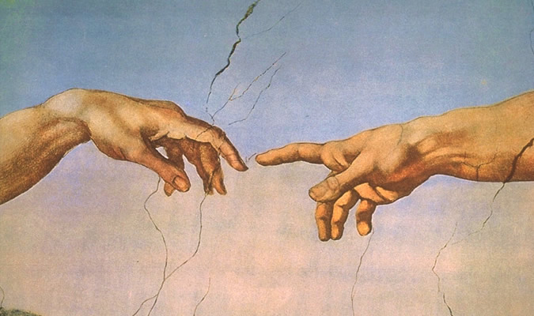
being in the image of god means that we are: created for relationships given response-ability called to love and serve we reflect the divine character of god!
Notes:
Essential dignity, quality and worth
Each of us bears the image of god, not deleted

Slide 6
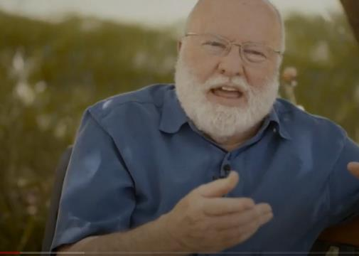
God For Along Side and Within
https://youtu.be/bkKLN1WGKlM

Slide 7
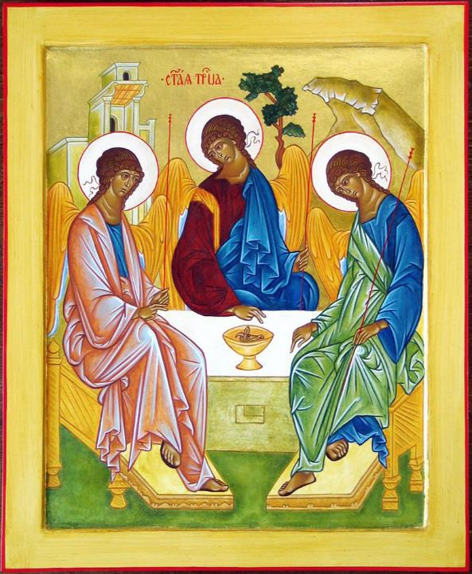
After Rublev’s Trinity
Each face turned toward a face at table leaving always a space for
one more. An open door to run through when someone can’t quite make it home
on their own. Though the wings work, humans haven’t got them, and it’s hard to
converse from heights so, in one hand a staff to lean on. The other hand ever reaches down. — Carrie Purcell Kahler
Reflect: where am I in this picture?

Slide 8
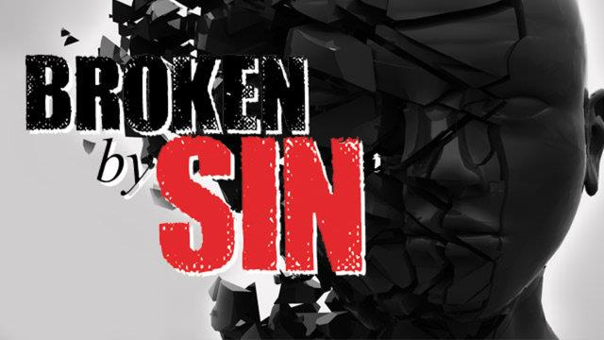
Notes:
Sin as broken relationships that has a devastating impact on all levels of relationship and shatters the image of God
In Christ, true image of God restored. As we are drawn to him, we are being remade, new creations.
In community, individually being transformed by HSp.
Past distinctions left behind, old attitudes, behaviours and ways of being now superseded.
God’s gift and creation-Body metaphor.
Unity in Christ, no part above the other, all equal worth and belonging.

Slide 9
Notes:
True but the lived reality is that there is a tension inside me between 2 realities

Slide 10
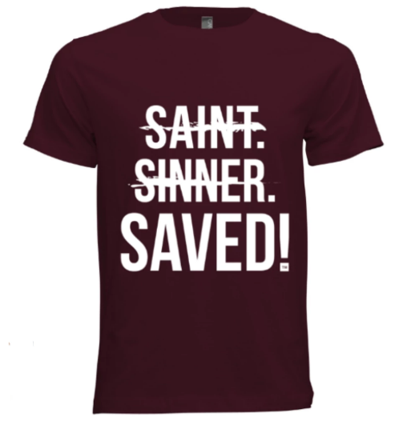
I don’t understand myself at all, for I really want to do what is right, but I can’t. I do what I don’t want to—what I hate. I know perfectly well that what I am doing is wrong, and my bad conscience proves that I agree with these laws I am breaking. But I can’t help myself because I’m no longer doing it. It is sin inside me that is stronger than I am that makes me do these evil things.
So you see how it is: my new life tells me to do right, but the old nature that is still inside me loves to sin. Oh, what a terrible predicament I’m in! Who will free me from my slavery to this deadly lower nature? Thank God! It has been done by Jesus Christ our Lord. He has set me free.
St Paul in Romans Ch. 7

Slide 11
Saint and Sinner (Simul Justus et pecator)
When I get honest, I admit that I am a bundle of paradoxes. I believe and I doubt, I hope and get discouraged, I love and I hate, I feel bad about feeling good, I feel guilty about not feeling guilty. I am trusting and suspicious. I am honest and I still play games. Aristotle said that I am a rational animal; I say I am an angel with an incredible capacity for beer.“
Brennan Manning

Slide 12
Loved back to life
https://www.theworkofthepeople.com/loved-back-to-life

Slide 13
‘Those jagged edges of our humanity are the places where God gets hold of us’
‘When we get things wrong, that’s not the thing that defines us, not the final word.’
Discuss with a partner:
What do you think all this means for our relationships with others?

Slide 14
Notes:
Metaphor to describe a divine reality-gift, God’s creation. It’s in this body that God shapes and call us in to service

Slide 15
Occupation
What I do, what occupies my day 9-5, what I get paid for, my job.
Vocation
Why I do what I do, my calling/purpose in life, the reason I get out of bed.

Slide 16
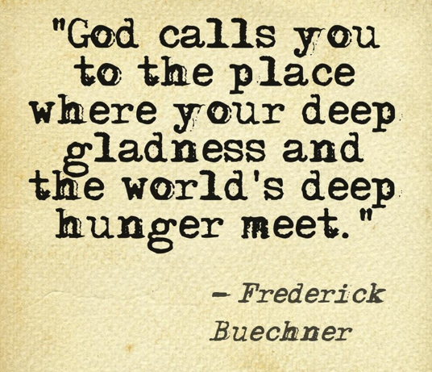

Slide 17
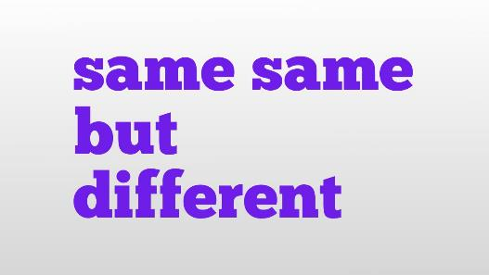
Your Vocation is not the same thing as your Occupation, though our occupation should be a way to express/live out our vocations

Slide 18
Society in medieval times was strictly divided into classes of people. Those who ruled, Those who fought, Those who worked Those who prayed.

Slide 19
Vocation-A medieval view
The religious people (priests, monks, nuns) were considered among the most privileged. While they may not have been wealthy or powerful, their life of dedication to prayer and worship meant that their work was considered sacred, holier than the ordinary work of everyone else.
When a medieval person thought about ‘vocation’, they understood living the religious life. That was the only real way to serve God.

Slide 20
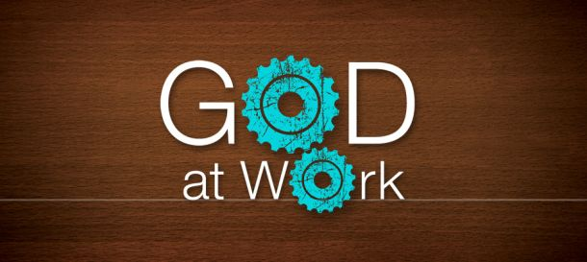
Martin Luther and the Reformers in 1500’s turned these ideas upside down.
There was no longer sacred vs secular kinds of work.
All work is sacred because it is the way we serve each other and share in God’s care for his creation.
Through our vocations, God is at work through us whether we know it or not.
And because God is at work,
All work becomes holy,
Not just the obvious religious stuff

Slide 21
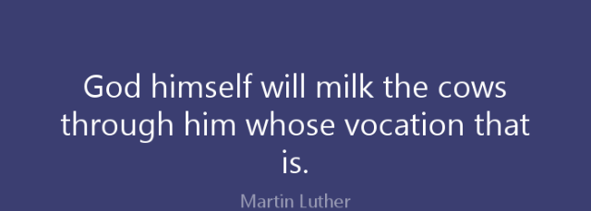

Slide 22
God at work
In God’s design, each person is to love his or her neighbours and to serve them with the gifts appropriate to each vocation. This means that I serve you with my talents, and you serve me with your talents. The result is a divine division of labour in which everyone is constantly giving and receiving in a vast interchange, a unity of diverse people in a social order whose substance and energy is love.
Gene Veith

Slide 23
Take a minute to note some of the many roles you play and who you serve in that role.
E.g. Role: Teacher
Key duty: to educate
People served: students

Slide 24
Read the article by Gene Veith; ‘The masks of God’.
Note anything that stood out for you and helped you understand the concept of ‘Vocation’.

