Slide 1

National School Pastors / Chaplains Conference
August 2015
[Stephen Rudolph]

Slide 2
Lutheran Education Australia
Lutheran Education Communique
CoD NLT
LEA strategic plan [GCC/LEA/regions including directors and chairmen]
  Strengthening Lutheran identity
  Thriving learning communities
  System sustainability
LCA governance and administration review
LEA branding
[Stephen Rudolph]

Slide 3

ACLE 5
People Planet
Purpose
Linking past present & future in Lutheran education
[Stephen Rudolph]
PEOPLE
Edu-reformation
PLANET
Eco-reformation
PURPOSE
Ego-reformation

Slide 4
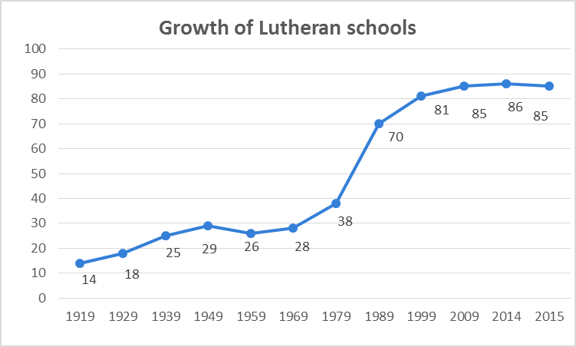
Growth of Lutheran schools
[Stephen Rudolph]

Slide 5
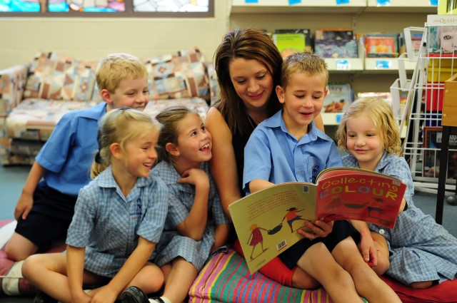
Enrolments: annual percentage growth
Average annual enrolment growth 1984-2013 = 4.52%
2013 growth 2.2%
2014 growth 1.6%
Average growth 1983-2014 = 4.4%
Average growth 2012-2014 = 2.1%
[Stephen Rudolph]
Notes:
Stephen Rudolph

Slide 6

Enrolments: by religion
[Stephen Rudolph]

Slide 7
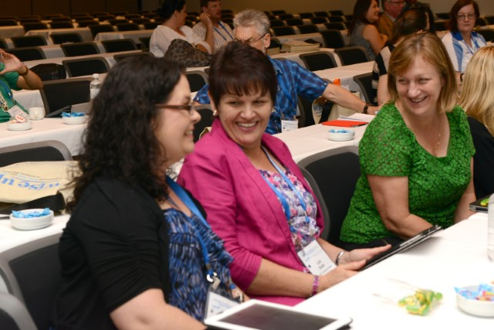
Staff: by religion
[Stephen Rudolph]
Notes:
This provides rationale for Equip

Slide 8
Religious affiliation by census year
 | 2001 | 2006 | 2011 | %change 2001-2006 | %change 2006-2011
Anglican | 3,881,162 | 3,718,247 | 3,679,907 | -4.2 | -1.0
Baptist | 309,205 | 316,741 | 352,497 | 2.4 | 11.3
Catholic | 5,001,624 | 5,126,884 | 5,439,267 | 2.5 | 6.1
Eastern Orthodox | 529,444 | 544,163 | 563,072 | 2.8 | 3.5
Lutheran | 250,365 | 251,103 | 251,930 | 0.3 | 0.3
Presbyterian/Reformed | 637,530 | 596,667 | 599,515 | -6.4 | 0.5
Seventh Day Adventists | 53,844 | 55,252 | 63,002 | 2.6 | 14.0
Uniting | 1,248,674 | 1,135,427 | 1,065,794 | -9.1 | -6.1
Source: Pointers, CRA Vol 22 No 3, September 2012
[Stephen Rudolph]

Slide 9
Weekly church attendance by denomination (1996-2006)
According to CRA calculations based on various surveys between 1996 and 2006, the numbers attending on a typical Sunday in Australia declined in the following denominations:
36% Presbyterian
31% Uniting
25% Lutheran (1996: 46,200 – 2006: 33,000 [*])
19% Catholic
12% Anglican
1% Seventh Day Adventist
The numbers attending the following denominations grew:
+ 88% Oriental Christian
+ 27% Pentecostal
+ 25% Brethren
+ 11% Baptist
+ 3% Salvation Army
[* 2011 Lutheran weekly attendance 25,000 average]
[Source: Pointers, CRA, Vol 21, No 4, December 2011]
[Stephen Rudolph]

Slide 10
Lutheran education
Socio-cultural issues and LEA papers
Requests via principals, pastors/chaplains, regional staff
NLT / CoB
[Paul Weinert]

Slide 11
Lutheran education papers
  People whose worldview is other than Christian within Australian Lutheran school communities (hard copy available)
  People in same sex relationships within Australian Lutheran school communities (to be distributed to school principals and councils in early 2016)
  Diverse views on science and faith within Lutheran school communities (to be distributed to school principals and councils in early 2016)
  Caring for creation within Australian Lutheran school communities (to be distributed to school principals and councils in early 2016)
[Paul Weinert]

Slide 12
  Lutheran education future papers ?
  Your comments, feedback and future paper suggestions
  Feedback to LEADirector@Lutheran.edu.au
[Paul Weinert]

Slide 13
Growing deep
[LEA Leadership and Formation Framework]
Lutheran education is grounded on Christian beliefs and values and strives for excellence in all dimensions of learning and teaching. The gospel of Jesus Christ (which) informs all learning and teaching, all human relationships, and all activities is the lens through which Lutheran education is viewed. [The LCA and its schools, 2001]
When this is fully realised this means that:
Lutheran schools, as part of the mission of the Lutheran church, are communities sharing and living the good news of Jesus Christ.
Lutheran schools are communities which acknowledge God as creator and join in the ongoing care of the world. Staff and students are created intentionally and are uniquely gifted to live in relationship with God and with each other.
Lutheran schools are communities which recognise the brokenness of humanity and yet are places where grace abounds, reflecting the unconditional love of the Father, revealed through the saving work of his Son, Jesus.
Lutheran schools are communities open to the influence of the Holy Spirit, who invites and equips for a life of worship and service.
Lutheran schools are communities that value knowledge and learning as God’s gifts to people for their growth and enables them to respond to the needs of the world.
Lutheran schools are communities of hope, based on the promises of God’s Word which empower staff and students to face the future with confidence.
[Stephen Rudolph]

Slide 14
Growing deep
[LEA Leadership and Formation Framework]
  Five vocational practices
  Excellence in teaching and learning
  Ongoing improvement and innovation
  Strengthening Lutheran identity
  Community building
  Leading effective organisation and management
  Aligned with the draft School pastor / chaplains: Key elements for position description
[Stuart Traeger]

Slide 15
Lutheran education resource document
  ‘School pastor / chaplains: Key elements for position description’
  Your feedback and suggestions requested by end September 2015
  Principal and regional feedback will be requested by end November 2015
  Presentation to NLT and BLEA in March 2016
  Inclusion in LE eLibrary resources in 2016 for local contextual development and use
[Stuart Traeger]

Slide 16
Conference discussion
  Localised development and use
  Questions and feedback
  Further comments to LEADirector@Lutheran.edu.au
[Stuart Traeger]

Slide 17
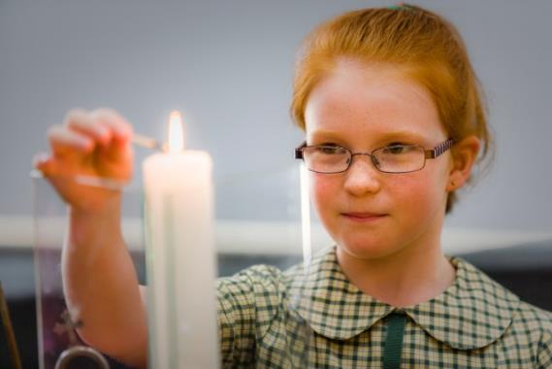
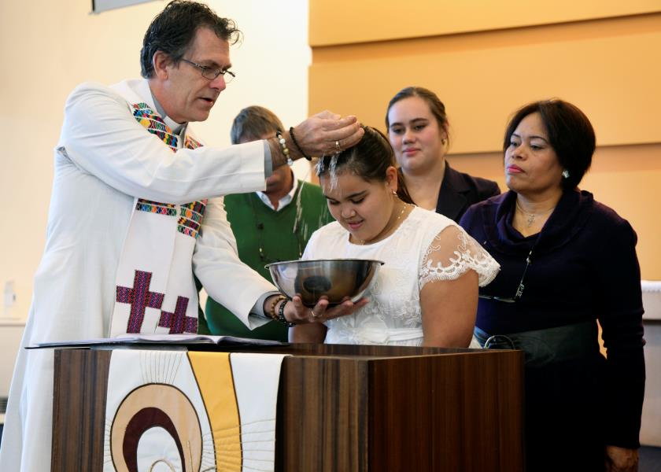

Lutheran schools
. . . places of ministry and mission to the Australian community
[Stephen Rudolph]

