Slide 1
Module 10
What happens when things go wrong?
The human condition and related consequences
God’s response to a broken world
Caring thinking, creative thinking

Slide 2
Purposes of the day
For participants to:
identify pedagogical principles of caring thinking and creative thinking, and links with theology
engage with the theology of CB3 and arrive at deep understandings relevant for students
consider potential links between CB3 and CC3 for studied topics
experience and plan for ways in which the focus pedagogy can be applied to teaching Christian Studies
2
Notes:
2

Slide 3
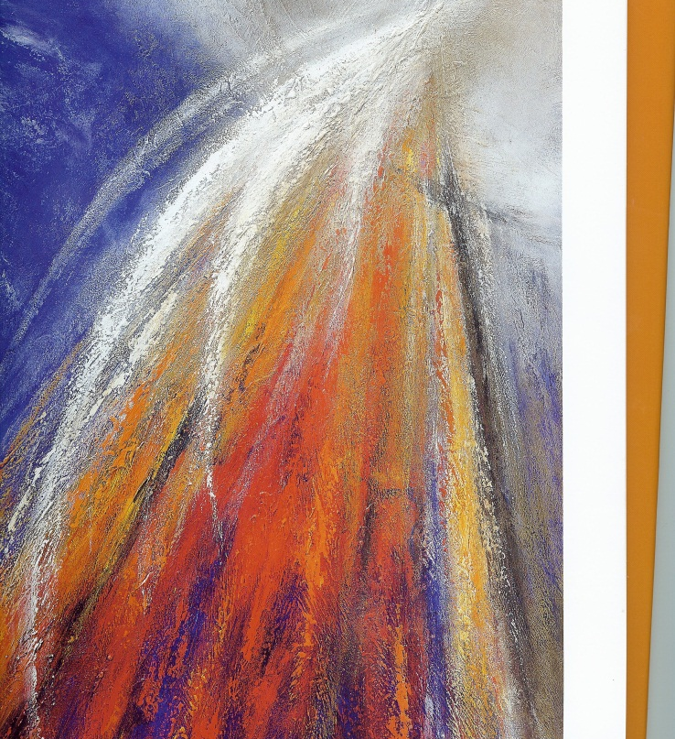
Plan of the day
Welcome
Engaging with the concept of what happens when things go wrong?
A pedagogy for the soul – caring and creative thinking
Exploring the CB3 theology (developing the concept and linking to CC3)
Close with reflection
3
Notes:
3

Slide 4
Psalm 121
1
I lift up my eyes to the mountains— where does my help come from?
2
My help comes from the Lord,
the Maker of heaven and earth.
3
He will not let your foot slip—
he who watches over you will not slumber;
4
indeed, he who watches over Israel
will neither slumber nor sleep.
5
The Lord watches over you—
the Lord is your shade at your right hand;
6
the sun will not harm you by day, nor the moon by night.
7
The Lord will keep you from all harm—
he will watch over your life;
8
the Lord will watch over your coming and going
both now and forevermore.

Slide 5

Where are we at?
What do people (young and old) most want when they find themselves in a difficult place?
What do you and your students wonder about when you find yourself in a hard place?
See “I wonder” worksheet

Slide 6
through a glass darkly Caroline Jones (2009)
My father has the stoic courage which is the emblem of his generation…they accept that suffering is part of the experience of being human, to be endured with dignity, patience and not much discussion…I feel despondent that I cannot stop his suffering, but also proud of him, learning from his bravery, and, in a way that I do not understand, exalted by his acceptance and dignity. Page 81

Slide 7
through a glass darkly Caroline Jones (2009)
People tell me its rare to find someone who listens. I agree. When it happens it helps – not because the listener can stop your sadness or heal your hurt or tell you what to do. I think the value lies in just being with a person, being prepared to hear their hard experiences, providing a time and place for the wounded psyche to express its suffering and for that pain to be accepted as legitimate. page 94 (speaking to a group of parents who have lost children)

Slide 8
through a glass darkly Caroline Jones (2009)
If God designed this human life, what sort of heartless tyrant is God? I am appalled to hear myself asking this question. On the other hand, if he suffers with us in our predicament but cannot alleviate it, then who will protect us? Who will make sure that it doesn't all go too far, beyond endurance? Page 146

Slide 9
Mark Worthing
“For four years we watched him [son] struggle and be tormented by his inner demons and the loss of all his hopes and dreams until the pain became so unbearable that he took his own life. There was no comfort in prepackaged explanations of evil and suffering.”

Slide 10
Mark Worthing
YET
“To not address the problem of evil and suffering as if it did not exist would be irresponsible and a neglect of duty. To roll out a set of prepackaged logical explanations can leave students cold or even turn them away from God and faith.”
So what do we do?

Slide 11
All of module 10 workshop is planning a unit
Use either Planning a learning journey worksheet
OR Take an A3 sheet and fold into three both lengthways and width-ways creating nine spaces to record ideas for planning a unit around CB3
OR
Planning for deep understanding worksheet

Slide 12
A process for planning
What do my students need to understand, know and do? How will I know students have gained understanding and knowledge? What will facilitate learning that will achieve unit objectives? | Context Identify the context in which you plan to teach your unit Determine student needs, interests and backgrounds that will shape unit focus | Key Idea Select the key idea(s) and outcome(s) that will form the basis of the unit
Learning Experiences Identify learning experiences that may help support students explore, inquire and demonstrate what they know and can do. Select relevant resources including the LIFE resource |  | Knowledge / understandings Select relevant content from knowledge indicators and theological notes Formulate deep enduring understandings students need
Assessment Brainstorm assessment task/s that will provide the required evidence of student learning Select criteria by which learning will be assessed | Evidence What evidence will you need in order to decide what the students know and can do in relation to the outcomes, knowledge, deep understandings? | Question / Inquiry Path Consider essential question(s) that will engage students in purposeful inquiry
Designed by LEQ, 2007

Slide 13
Does grace work?
What do I/ my students need to know?
What challenges/ barriers/ obstacles face me, my students?
How will I know I/ my students have moved forward?
How can I help myself and my student overcome misconceptions?
What will help students and myself engage with sensitive, difficult ideas and questions?
How might caring and creative thinking help me and my students work through the challenges before us?

Slide 14
CSCF CB3
Curriculum Statements,
)
Read the outcome, scope statement and knowledge indicators for your Band level and consider:
With what understandings, concepts regarding
suffering
human reactions and actions,
God’s response
will students be engaging?
Record ideas on your planning page
14

Slide 15
Biblical text, concepts
BRIDGING THE GAP
Student realities

Slide 16
A pedagogy for the soul
AC – personal and social capability, critical and creative thinking http://www.australiancurriculum.edu.au/GeneralCapabilities/Personal-and-social-capability/Introduction/Scope-of-Personal-and-social-capability

Slide 17
DAN Conference 2013
Educating the mind without educating the heart is no education at all. (Gleeson)
How we wrestle is who we are (Gleeson)
Reasoning is more than rational. The mind thinks with feeling and a mind without feeling cannot reason well, making poor judgements and impelling loss of self-esteem and efficacy (T Lovat)
Leigh Burrows – mindfulness
  http://blogs.flinders.edu.au/flinders-news/2013/02/01/mindfulness-to-create-calm-in-the-classroom/

Slide 18
ACLE + more
ACLE Dr Thomas Nielsen – curriculum of giving
  http://www.thomaswnielsen.net/?q=node/7
  one of the healthiest things we can do is to give, as this leads us to being healthier, happier and possibly even to living longer
Wiggins and McTighe - Understanding facet 5 - empathy
  Can empathize: find value in what others might find odd, alien, or implausible; perceive sensitivity on the basis of prior direct experience.

Slide 19
Caring and creative thinking
2 groups
Caring thinking Readings 7 (PB)
Creative thinking Reading 8 (PB)
Create a WORD wall of key concepts – note; you are teaching one another about the concept (alternate strategies: WORDLE/ PADLET
Caring thinking http://padlet.com/wall/Mod10caringthinking
Creative thinking http://padlet.com/wall/10creativethinking

Slide 20
Reflect and discuss
  Thinking, feeling and learning are inextricably linked (Pohl, 1997). What evidence is there of this in your classroom?
  Share examples of caring or creative thinking from your CS classrooms

Slide 21
What happens when things go wrong?
STRATEGY
Create a mind map e.g. double bubble map of Part 1 and Part 2 OR use the bridge map strategy PB page 7
Make notes about the following:
  The nature of ‘wrong’ – what makes something wrong for a person?
  Words people use to describe suffering –vocabulary of wrong
  Emotional, physical, practical relational realities of people who find themselves in a hard place
  Questions people ask
  How God is spoken about

Slide 22
PART 1 – insights from stories
22
See handout
People stories
Jesus storties
Old Testament stories Stories from The Lutheran – see readings 1- 6
Songs and hymns
Art work
Film/YouTube

Slide 23
Part 2 - Is GOD caring? creative?
Choose one of the selection from the following writers:
CB3 Theological Notes
Worthing, The fragility of grace (grace)
Cooke, Where was God when... (evil, suffering, faith)
Bonhoeffer, Grace and discipleship (grace, suffering, cross of Christ, discipleship)
Yancey, Why forgive? (grace, forgiveness)
Vardy, Can God act in the world? (evil, suffering, God’s action)
Nouwen, The agony of Christ (response to suffering)
What insights do the above giove on suffering, hope, grace, forgiveness
Record questions the reading raises for you.

Slide 24
Dealing with difficult questions
Does God send accidents to teach us things?
Does God will earthquakes, floods, droughts, tsunamis?
Is suffering sent to test my faith and love?
Why do children die but old people who want to die live?
Do we suffer so God can be glorified?

Slide 25
What do my students need to know?
What important truths do they need to grasp about sin and grace?
What Bible stories will open up the understandings ?
What picture books can I use?
How might I use the Christmas story?
What strategies will best help open up the discussion?
What assessment task will show their understanding?
TASK: Create a series of caring and or creative thinking activities
Use two or more of de Bono's Six Thinking Hats to explore bible stories that provide insight into the concept of sin/grace/hope/forgiveness. You may wish to use alternate strategies to de Bono's hats - see caring thinking and creative thinking ideas especially core components on caring thinking or any of the following strategies:
OR
Select three metaphors of sin/grace/hope/forgiveness and create a T-chart to explore the strengths and limitations of the metaphors

Slide 26
Reflecting on the journey so far
what has been my most significant learnings as a CS teacher whilst completing Equip?
how have I changed as a CS teacher?
how has articulating my CS philosophy impacted upon my teaching of CS?
how do I understand assessment and CS?
which of the theological or pedagogical components of Equip has had the greatest impact on my CS teaching?
how would I describe my journey with inquiry in the CS classroom?

