Slide 1
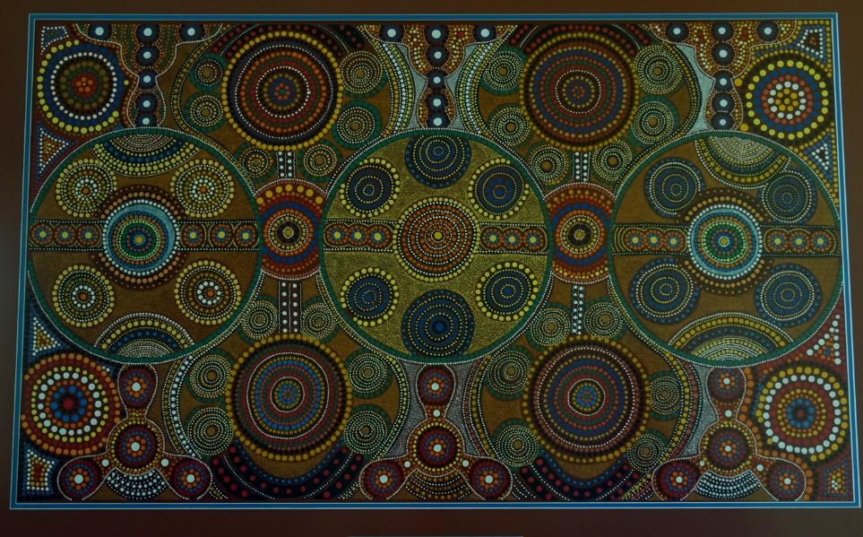
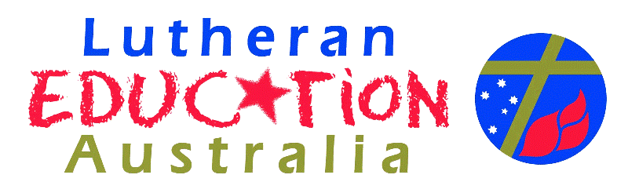
Introducing Indigenous culture and spirituality
Artist: Annie Young
Notes:
Australian Curriculum: O I.3 Aboriginal and Torres Strait Islander Peoples have unique belief systems and are spiritually connected to the land, sea, sky and waterways.
This work shop will look at Indigenous culture and spirituality.
It will be divided into three aspects; The Dreaming, the missionaries and modern times.
The Aboriginal and Torre Strait Islander voice will be heard through art work and quotes.
Torres Strait Islander people did not have ‘The Dreaming’, they have legends about the Tagai.
The art work by Annie Young is painted in the Keringke Style, found at Santa Teresa (Ltyentye Apurte) NT. This art work is hanging at Endeavour College, Mawson Lakes, South Australia.
Annie uses symbols that represent landscape and spirituality. This artwork was painted to represent the school. Groups of students meet around central points, different colours represent different types of people. All of the groups are linked together to represent the unity of the faith of the school. Information about Santa Teresa can be found at
http://www.darwin.catholic.org.au/aboriginal-communities/sub-ltyentye-apurte.htm. Images of art work can be found at http://keringkearts.com.au/artworks/

Slide 2
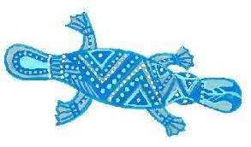
For since the creation of the world God’s invisible qualities – his eternal power and divine nature – have been clearly seen, being understood from what has been made, so that men are without excuse. Romans 1: 20
Notes:
Romans 1: 20
Art work, Australian Indigenous Images, Volume 1: Culcha Disc

Slide 3
The Dreaming
Environment
Social Structure
Moral code
The three main elements of The Dreaming are interrelated and connected
Notes:
All Dreaming stories consist of 3 main elements, they describe how the environment was created, provide a moral code and explain the social structure in story form and through song, art and dance.

Slide 4
What is the Dreaming?
The Dreaming comes from the land and is as diverse as the many Indigenous language groups in Australia
It tells of the ancient, ancestral Beings who formed the land and travelled across it in the form of humans, plants and animals
Country was made during the Dreaming
It deals with how Indigenous people live their lives now
It involves secret and sacred business
Notes:
The next 4 slides will explain in simple terms what The Dreaming is. We understand about the Dreaming through the Dreaming stories that non Aboriginal people are able to read. Ensure that the Dreaming stories and films watched are written and produced by Aboriginal people. There are many available on You Tube to watch, and a large amount are written as story books. Some of the stories are secret and sacred to the Aboriginal people and can not be shared with other people.
The following quote provides a good starting point to understand what the Dreaming is.
The central meaning of The Dreaming is that of a sacred, heroic time long ago when man and nature came to be as they are; but neither time nor history as we understand them is involved in this meaning… Although the dreaming conjures up the notion of a sacred, heroic time of the indefinitely remote past, such a time is also, in a sense, still part of the present. One cannot ‘fix’ The Dreaming in time: it was, and is, every where…Clearly, The Dreaming is many things in one. Among them, a kind of narrative of things that once happened; a kind of character of things that still happen; and a kind of logos or principle of order transcending everything significant for Aboriginal man… It is a cosmogony, an account of the begetting of the universe, a study about creation. It is also a cosmology, an account or theory of how what was created became an ordered system. To be more precise, how the universe became a moral system (Stanner 1979:23–4, 28)
Stanner, W. E. H. 1979, White Man Got No Dreaming, ANU Press, Canberra.
An activity with staff could be to discuss this quote in pairs and then in a larger group.
Aboriginal languages contain a lot of words for spirituality and beliefs, such as
tjurkurrpa, jukurrpa, tjurgurba (Pitjantjatjara people, north-western South Australia),
altjeringa, alcheringa, alchera, aldjerinya (Arrernte people, central Australia),
palaneri,
bugaregara,
ngarangani,
ungud (Ngarinyin people, north-Western Australia),
wongar (north eastern Arnhem Land),
bugari (Broome, north-Western Australia).
There is no spelling orthodoxy because native speakers did not write down Aboriginal languages.
It is collectively known as The Dreaming when talked about in English.
Photography, Akurra at Yaki, Flinders Ranges. Photography copyright Adele Pring
.

Slide 5
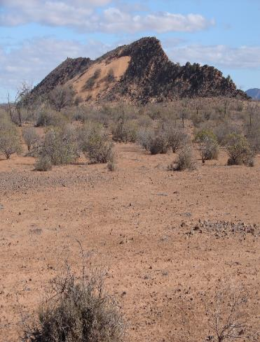
What is the Dreaming ?
The Dreaming creatures are travellers. Their paths pass over, under and upon the land
Sites along these paths are often named and treated as especially important
These journeys are told in stories and songs
The stories and songs can link places and people
hundreds of kilometres apart
Notes:
The paths of the Dreaming creatures are known as ‘song lines’ and are still present today. As the Elders die many of the song lines are being lost and there is a push by academics and researchers to record as many of the song lines as possible. An example of a South Australian song line is the Tjullbruke Trail. This is available on the internet: http://en.wikipedia.org/wiki/Tjilbruke and http://www.holdfast.sa.gov.au/page.aspx?u=1465.
Information about song lines can be found at this web site: http://en.wikipedia.org/wiki/Songline
Activity with staff, read the song line information on Wikipedia and discuss how a song line is a map of country and can be compared to a contour map used today.
Look up some of the examples of song lines and follow them as a map of country.
For example the Tjulbruke song line shows where water holes are and where to find baruke (iron pyrites) to make fire. The story goes over Peramangk, Kaurna and Ngarridjeri land. It also explains the importance of totems, relationships and burial procedures. This activity could also be used with students
Photography, Goanna and Native Cat Dreaming, Flinders Ranges. Copyright Adele Pring

Slide 6
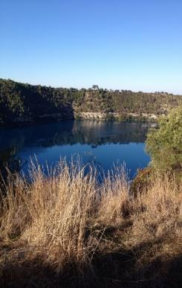
What is the Dreaming ?
The Dreaming is expressed in two facts of existence
  It is the land – creek, hills, clay pans, rock holes, soaks, mountains and other natural features
  It is the people – their actions of hunting, marrying, ceremony and daily life
The Dreaming is existence itself, in the past, present and future
It explains existence and it is the law that governs behaviour
Notes:
The Dreaming expresses how the land was created, and provides details about the social structure and moral code of the Aboriginal people.
The Dreaming occurred in the past, but is still part of the present and the future.
The Dreaming provides the law that governs the way all people are suppose to behave.
Photography, Blue Lake, Mt Gambier – The Craitbul Dreaming Story. Photography, copyright, Christine Reid

Slide 7
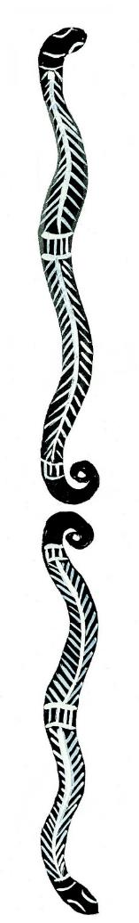
What is the Dreaming ?
The Dreaming gives a charter for living
Shows what is the correct way of being in the world and of living with each other
Explains the restrictions on the use of land and its resources
Explains the rules of marriage
Explains what is public and what is secret knowledge
Shows the correct way of gaining knowledge and teaching it
Explains responsibilities of people toward each other and their country
Notes:
Art work, Australian Indigenous Images, Volume 1: Culcha Disc

Slide 8
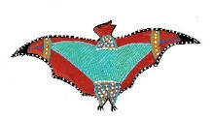

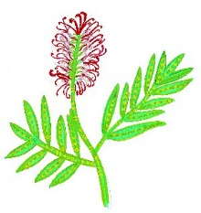
The circle represents the inter-connectedness of all things and highlights the variety of aspects of culture and environment that can be focussed upon when studying stories from the Dreaming.
Astronomy
Animals
Food
Relationships
Songs
Plants
THE DREAMING
Art
Language
Land
Technology
Spirituality
Behaviour
Adapted from *W H Edwards’
Introduction to Aboriginal Societies
Notes:
The wheel shows us that The Dreaming encapsulates all aspects of life. The stories explain the spiritual, the physical and the relationships between people. The Dreaming stories can be investigated through telling, dancing, looking at themes, comparing similar stories from different language groups, acting, writing, painting, singing, investigating.
Dreaming stories pass on important knowledge, cultural values and belief systems to later generations, this is done through song, dance, painting and storytelling which express the Dreaming stories,
When the ancestor spirits had finished creating the world they changed into the trees, rocks, rivers, stars and other physical objects. These are now the sacred places for the Aboriginal people. The Dreaming is never-ending, it links the past and the present to the people and the land.
The website 12 canoes provides small films and photographs that show the interconnectedness of the Dreaming: http://www.12canoes.com.au/
*W H Edwards, Introduction to Aboriginal Societies, Social Science Press, Wentworth Falls, NSW 1988, the second edition was published by Thomson in 2007.
Art work, Australian Indigenous Images, Volume 1: Culcha Disc

Slide 9
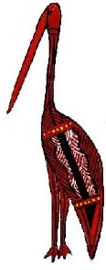
What does the Dreaming mean to Aboriginal people today ?
By living on their land and learning about the Dreaming, Aboriginal Australians understand the connection between people, places and the Dreaming
To be socially responsible you must learn the names of tracks, places and songs of your Dreaming
People become emotionally attached the place where they were born
Knowledge of the songs and paths tells people where they are and where they are going without maps and compasses
Notes:
Art work, Australian Indigenous Images, Volume 1: Culcha Disc

Slide 10
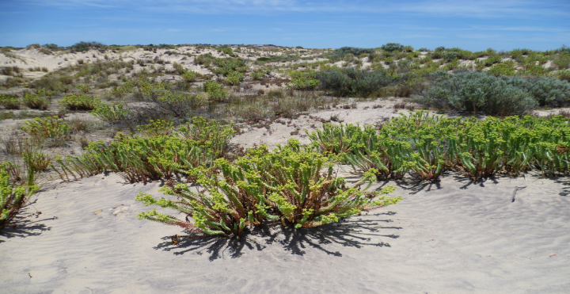
What does the Dreaming mean to Aboriginal people today ?
Bonds between Aboriginal people and land can never be broken while a person lives
The link remains even at death, then they become part of the creation
Land must be cared for and protected
Protection of the essential nature of all things and a unique way of being
Notes:
Read Aunty Beryl Carmichael’s account of why the stories are told. Discuss this article in small groups and share insights gained about the importance of the Dreaming.
Why the Stories Are Told
Aunty Beryl Carmichael
My name is Beryl Carmichael and my traditional name is Yungha-dhu.
I belong to the Ngiyaampaa people, come from the Ngiyaampaa nation and the area we're in now belongs to Eaglehawk and Crow.
I'm a storyteller as well and all the stories have been handed down to me by my people. I am now custodian of about twenty-eight stories.
The stories are a wonderful and a valuable tool, an education tool in teaching our children. The 'Dreaming' stories as they are referred to today, we didn't know that there was such names for them. Because when the old people would tell the stories, they'd just refer to them as 'marrathal warkan' which means long, long time ago, when time first began for our people, as people on this land after creation.
We have various sites around in our country; we call them the birthing places of all our stories. And of course, the stories are embedded with the lore that governs this whole land. The air, the land, the environment, the universe, the stars.
The stories that we are passing and talking on today, we are hoping that, some way, it will help our people-and our children, our young people in particular-to get a better understanding about the lore that governs our lives today.
No matter what we do, there is always guidance there for us and the guidance comes through in the stories. And the direction that we are giving to our young people on how we expect them to grow up. How to listen to the old people, but also, never to be disobedient. We must never be disobedient; we must always obey the instructions of our old people and people in authority; always do the right thing; never be greedy; never be a thief and so on.
So all these little things are embedded in the stories to our children. That's why the stories are so powerful as an education tool when we're teaching our young kids. We must always refer back to the stories because they're the ones that are going to give them the guidance that they need today.
http://www.abc.net.au/tv/makingaustralia/educationextras/episode-four/downloads/MMA_tr4_e.pdf
Photography, Tjulbruke Dreaming, Kaurna, Moana Beach. Copyright Christine Reid

Slide 11
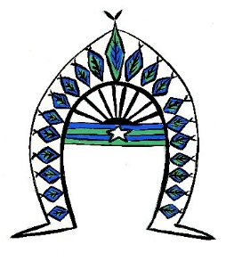
The Tagai
The Torres Strait people are united through the stories of the Tagai
These stories focus on the stars and the identity of Torres Strait Islanders as sea people
The Tagai’s instructions provided order in the world, ensuring that everything has a place
Notes:
Tagai Creation Story
One Tagai story depicts the Tagai as a man standing in a canoe. In his left hand, he holds a fishing spear, representing the Southern Cross. In his right hand, he holds a sorbi (a red fruit). In this story, the Tagai and his crew of 12 are preparing for a journey. But before the journey begins, the crew consume all the food and drink they planned to take. So the Tagai strung the crew together in two groups of six and cast them into the sea, where their images became star patterns in the sky. These patterns can be seen in the star constellations of Pleiades and Orion.
See more at: http://australianmuseum.net.au/indigenous-australia-spirituality#sthash.82q1mzkM.dpuf
Tagai – a warrior of the Torres Strait: http://aboriginalastronomy.blogspot.com.au/2012/01/tagai-warrior-from-torres-strait.html
http://www.nfsa.gov.au/digitallearning/mabo/info/tagaiMyth.htm
Art work, Australian Indigenous Images, Volume 1: Culcha Disc

Slide 12
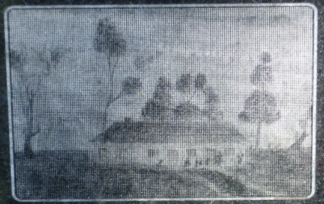
The coming of Missionaries
The first missionaries arrived in New South Wales in 1789
Larger numbers arrived in 1820, they came to protect the Indigenous peoples and to convert them to Christianity
    Many were shocked by the bloodshed and racial violence that was occurring
    They wrote accounts of the devastation, robberies, cruelties and murder that was occurring in many parts of Australia
Missionaries were Catholic, Anglican and Lutheran
They wanted the Indigenous peoples to give up their traditional beliefs and to believe in Jesus and the traditional Christian view of creation
Notes:
The next series of slides provide information about the coming of missionaries and the effect that this had on Aboriginal people.
There was a two fold reason; firstly to convert Aboriginal people to Christianity and secondly to protect Aboriginal people from the bloodshed and racial violence that was prevalent.
The missions varied considerable in the way they treated Aboriginal people, from paternalism to gaining insights of Aboriginal culture.
The word 'mission' is used in Aboriginal English to refer both to church missions and government-run reserves.
Hollywood Mission was government-run. This website provides personal information from an Aboriginal man who lived in a government run mission: http://www.nma.gov.au/exhibitions/from_little_things_big_things_grow/behind_the_scenes/memories_of_mission_life

Slide 13
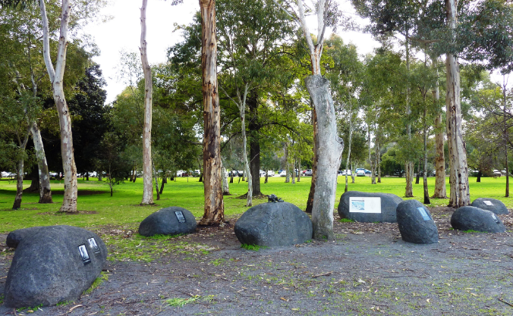
The coming of Missionaries
The missionaries fought for the protection of Aboriginal peoples from racial violence, particularly on the frontier
The missionaries were generally unpopular and were viewed as troublemakers by many of the general population
There was a belief that missionary activity was useless and a waste of money
Missionaries worked to protect the Aboriginal people by setting up missions
Notes:
Jessie Mitchell makes the following statement:
“Missionaries came to Australia as a result of humanitarian movements in England, which had been started to combat slavery, but also began with concern about conditions of indigenous people throughout the Empire. So what you get in missionary accounts is a great deal of paternalism, contempt or fear of aspects of indigenous culture, but also a lot of anger and distress and violence and poverty that was happening as a result of colonialism.” http://www.abc.net.au/radionational/programs/ark/missions-to-aborigines/3428910#transcript
Read this statement and discuss the pros and cons of missionaries and their influence on the Indigenous population of Australia.
The article provides some very interesting insights and is worth reading.
“Most Aboriginal peoples voluntarily moved to the missions and reserves, as they had already lost their land, hunting grounds and water sources. By moving to a mission, they were protected by the missionaries and received food and clothing. Some Aboriginal people left their family and clan to live on a mission, leaving the elderly people and children to look after themselves. This created a further breakdown of traditional Indigenous society.
Missions did save many groups of Aboriginal peoples who may otherwise have died from racial abuse, conflict, and starvation; but there was a price to pay. The Aboriginal peoples living on missions were forbidden to speak traditional languages or take part in traditional ceremonies and other cultural practices. Men, women and children were also often segregated on the missions so that the children could be taught the Christian way of life without the interference of the elders and other adults. This meant that traditional knowledge and beliefs were lost, as they were not being communicated to the young generation.
The British settlers and the missionaries had no respect for Indigenous laws, life and spiritual beliefs. The Aboriginal peoples that survived the impact of European diseases, frontier wars, racial abuse and dispossession were often put on reserves or missions where they lost the freedom to practice their traditional way of life and culture. The Aboriginal peoples were trapped between European society and their traditional way of life. They were meant to assimilate into the European Australian culture and society, but were not given any rights or respect. Even today, the Indigenous peoples are still fighting for rights and respect from the government and from many Australian people.”
Additional information can be found at http://www.skwirk.com/p-c_s-14_u-179_t-525_c-1963/managing-the-missions-and-segregation/nsw/managing-the-missions-and-segregation/aboriginal-colonisation-and-contact/settlement-1788-1850
Photograph of the sculpture situated at the Piltowodli site, North Adelaide, copyright Christine Reid

Slide 14
The coming of Missionaries
“It is one of the great tragedies of the recent history of Australia that true Christianity was for so long so very difficult to discern in the life of this outpost of a distant nation which called itself Christian” (pg 18)
“It is unfair to criticise these missionaries for being negative towards Aboriginal culture”, he notes, “while outside the missions Aboriginal people were being shot, tortured and sexually exploited by those who would deny them their very humanity” (pg 137)
Harris, J. 2012, One Blood:200 years of Aboriginal Encounter with Christianity
Notes:
Consider the two quotes on this slide and the information written below. Discuss the implications of what is quoted.
Harris in is book ‘One Blood’ argues that the missionaries had a very difficult time as the ‘Christianity’ they taught in the missions did not match the ‘Christianity’ that was being witnessed outside of the missions or in the life of the missionaries.
The three key factors according to Harris were:
”the low view of Indigenous society and culture
the brutal or immoral treatment of Indigenous people by many settlers
the gross contradictions between Christian values and the lifestyle of colonial white society. (pg.44)
This, along with the early missionaries’ failure to distinguish between the gospel and what they considered “civilisation”, European culture, seriously undermined their efforts to communicate Christ’s love to Aboriginal peoples.”
Despite their flawed approach, Harris credits the early missionaries for their adamant belief in the essential humanity of Indigenous people.
“It is unfair to criticise these missionaries for being negative towards Aboriginal culture”, he notes, “while outside the missions Aboriginal people were being shot, tortured and sexually exploited by those who would deny them their very humanity.” (pg.137)
Harris, J. 2013, One Blood (electronic resource): 200 Years of Aboriginal Encounter with Christianity, cover illustration by Sally Morgan

Slide 15

The coming of Missionaries
Torres Strait Islander people
Missionaries arrived in the 1870s
1 July, every year Torres Strait Islanders celebrate the “Coming of Light’, or the arrival of Christianity to the Torres Strait Islander people
  Fred Gela, Mayor of the Torres Strait Island Regional Council, explains “On July 1, 1871 the Torres Strait changed forever. On that day, Dabad, one of the tribal elders of Erub Island, met the missionaries at Kemus Bech, where he denied his tribal laws and accepted the good news of salvation” ('Lighting the way', Koori Mail 455 p 30)
Christianity was embraced and the light of God was welcomed into the everyday lives of the Torres Strait Islander peoples
Notes:
‘The Coming of the Light’ ceremony celebrates the arrival of Christianity to the Torres Strait. Additional information can be found at http://www.southbank.qm.qld.gov.au/Events+and+Exhibitions/Exhibitions/Permanent/Dandiiri+Maiwar/Torres+Strait+Islander+resilience/Coming+of+the+light#.VSsNYPmUeSo
http://www.australiangeographic.com.au/blogs/ag-blog/2011/12/torres-strait-islands-coming-of-the-light/
https://www.youtube.com/watch?v=koOmJUUKlSs
Art work, Australian Indigenous Images, Volume 1: Culcha Disc

Slide 16
German Lutheran and Moravian missionaries
Contact history is shaped by missions and reserves, with missionaries playing a prominent role in the lives of Aboriginal and Torres Strait Islander people
German Lutheran and Moravian missionaries established the earliest and the longest surviving missions in colonial Australia.
Of the 16 missionary ventures in Australia up to 1850, eight had German speaking staff
The eight missions were Wellington Valley, Blue Mountains; Mt Eliza, Western Australia; Zion Hill, Brisbane; Aboriginal school, Adelaide; Pt Lincoln, South Australia; Encounter Bay, South Australia; Lake Boga, Victoria
The remaining eight missions were The Parramatta School, Sydney; Wellington Valley (1825 – 1827), Blue Mountains; Lake Macquarie, Newcastle; Wybalenna, Tasmania; Yarra River, Victoria; Buntingdale, Victoria; Smithies Wesleyan School, Perth; Stradbroke Island, Queensland and New Norcia, Western Australia
Notes:
German Lutheran and Moravian missionaries played an integral part in the lives of Aboriginal Australians. Of the 16 missions up to 1850, 8 were staffed by German speaking missionaries.
Griffith University has researched this area of Australia’s history, information can be found at http://missionaries.griffith.edu.au/
http://en.wikipedia.org/wiki/Category:Australian_Aboriginal_missions provides a list of Aboriginal missions in Australia.

Slide 17
Lutheran Missionaries in
New South Wales
Wellington Valley Mission was one of the earliest missions to Aboriginal people in Australia, founded in 1830 it was active for 12 years
Rev. William Watson and Rev. Johann Simon Christian Handt were the missionaries
The mission had 10,000 acres and 500 pounds per annum to run the mission
A drought in the early days made living there very tough with little food
Handt moved away in 1837 and he was replaced by James Gunther
The mission closed in 1842 and a new mission was established at Apsley by Rev Watson
Notes:
Wellington Valley Mission was a Church Missionary Society mission with a Lutheran Minister as a missionary.
This mission was not successful, a long drought, arguments, misdealings all resulted in the mission closing in 1842.
http://missionaries.griffith.edu.au/

Slide 18
Lutheran Missionaries in Queensland
Zion Hill Mission, 1838 – 1848 was the first free European settlement
It had 650 acres of land and a grant of 450 pounds to run the mission
The first mission to be established in what was to be later named as Queensland
The first two missionaries were Carl Wilhelm Schmidt and Christopher Eipper
John Dunmore Lang had the plan of establishing a series of missions along the Australian coast north of Sydney to bring Christianity to the Aboriginal people and to stop attacks on shipwrecked sailors
The missionaries had limited success at converting the Aboriginal people but the missionaries themselves later became pioneers and farmers in this area and facilitated the settlement of Moreton Bay
Notes:
Other missionaries to arrive were Peter Niquet, mason; August Rode, cabinet maker; Johann Leopold Zillmann, blacksmith; Gottfried Hausmann, farmer; Wilhelm Hartenstein, weaver, Carl Theodor Franz, tailor; Gottfried Wagner, shoemaker, August Albrecht, shoemaker and Ludwig Doge, gardener.
An additional two more missionaries arrive in 1844; Carl Friedrich Gerler and J.W. Gericke.
Initially the local Aboriginal people attended the services, built dwellings and dug gardens. Interest gradually waned and thefts occurred in the gardens. The missionaries did not retaliate for the stealing.
By 1843, it was becoming apparent that the mission was in trouble and the missionaries were advised to move to a new site if they wanted to continue to receive funding.
Despite the failure of the missionaries to convert the local Aboriginal people to Christianity they did establish a settlement and had a strong effect on the social character of the colony that developed after the closure of the mission.
Many roads and landmarks in North Brisbane are named after the missionaries.
http://missionaries.griffith.edu.au/

Slide 19
Lutheran Missionaries in South Australia
George Fife Angas recruited missionaries from the Dresden mission society for the South Australian settlement scheme
Angas provided the following instructions to the missionaries: “They were to learn the language and customs of the Aborigines of Adelaide, establish a school, and then move towards establishing a Moravian-style settlement in the interior, the junction of the Murray and Darling with its river access to Adelaide being the most suitable spot. Such a settlement would be essential to the success of the mission and here the Aborigines would be taught the arts of civilised living and growing food as well as Christianity.”
Schürmann and Teichelmann arrived before the German settlers in 1838
  They received very little monetary support
  Immediately on arrival Teichelmann and Schürmann began learning the local language, customs and beliefs
  They took every opportunity to mix with the Kaurna, attending their ceremonies, and having them to stay in their homes
  Schürmann accompanied them on long hunting expeditions and developed close relationships with a number of indigenous men
Notes:
Information about Schürmann and Teichelmann can be found at these sites:
http://adb.anu.edu.au/biography/teichelmann-christian-gottlieb-13213
http://adb.anu.edu.au/biography/schurmann-clamor-wilhelm-13284
The missionaries noted Angas’ instructions but they saw themselves firstly as missionaries of the Dresden Mission Society. Their priority was to bring to the Indigenous people, the Gospel of the grace of God. They knew this would transform aspects of indigenous culture, but they did not define their goals in terms of civilisation, Europeanization, or assimilation. They envisioned land reserved for Indigenous use where Aborigines would be preserved as a people, retain their language, communities and aspects of their culture, only gradually adapting to the invaders’ culture or learning English as necessary. They would be instructed and literate in their own language, into which the Scriptures and confessional writings would be translated, opening them to God’s grace and leading to the formation of Lutheran Aboriginal congregations.
The writings of Schürmann and Teichelmann are now being used to reclaim the Kaurna language.
The following resources have provided an insight into the Kaurna culture and the life of the missionaries:
Edwin Schürmann’s I’d Rather Dig Potatoes, Clamor Schürmann and the Aborigines of South Australia 1838-1853. (This book is available through Löhe Memorial Library in Adelaide.
C. G. Teichelmann, Aborigines of South Australia: illustrative and explanatory notes of the manners, customs, habits, and superstitions of the natives of South Australia, Adelaide, 1841;
C. G. Teichelmann and C. W. Schürmann, Outlines of a grammar, vocabulary, and phraseology, of the aboriginal language of South Australia, spoken by the natives in and for some distance around Adelaide, Adelaide, 1840.
http://missionaries.griffith.edu.au/missionary-training/hermannsburg-mission-society-1849

Slide 20
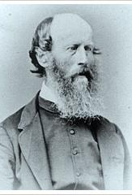
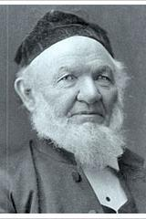
Lutheran Missionaries in South Australia
In December 1839 Schürmann began a school for Kaurna children at Piltawodli
Teichelmann worked with Kaurna adults
Klose took over the school in 1840
Piltawodli became a boarding school in 1843
The children were taught in Kaurna language until Governor Grey insisted that English was to be used to teach the children
In 1845 Piltawodli amalgamated with the Native Training Institute set up by Grey
In 1846 Klose’s employment and the government support for the missionaries was terminated
Notes:
The missionaries cared for the physical well being of the people, they disagreed with the prevailing thought that considered Aborigines “a race of beings differing little from the higher animals.” Teichelmann believed that they had “the same gifts and talents as Europeans.” Schürmann wrote in his diaries “One finds a vivacity, intelligence and cleverness among them:” and “their busy, restless spirit betrays the image of God in them also.”
http://www.lmw-mission.de/files/lockwood-a-vision-frustrated-5136.pdf
Photographs of German missionaries, Teichelmann and Schurmann

Slide 21
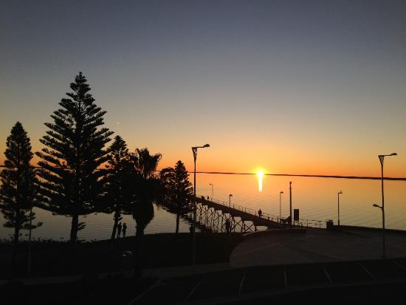
Lutheran Missionaries in South Australia
1840 – Meyer and Klose expanded their work to Encounter Bay and Port Lincoln
Early 1900s the Mission work expanded to the far west coast of South Australia
Early 1950s, Yalata was established for the dispossessed people of Maralinga
AbMinSA has a current ministry in Yalata, Oak Valley, Ceduna, Koonibba, Port Lincoln, Whyalla, Port Augusta and Adelaide
Notes:
For more information go to http://www.sa.lca.org.au/?q=mission/aboriginal-ministry
and at
http://missionaries.griffith.edu.au/missionary-training/hermannsburg-mission-society-1849
Photograph, Ceduna, copyright, Christine Reid

Slide 22
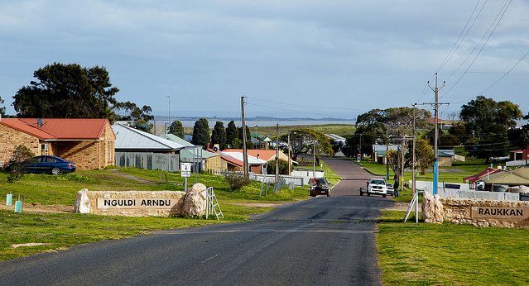
The coming of Missionaries
Many mission settlements became government reserves or stations, for example in NSW Cumeragunja, Warangesda and Brewarrina became government reserves
The reserves had their own machinery and farmed their own crops and livestock. By 1911 there were 115 reserves
Aboriginal people were heavily restricted in their access to land and freedom of movement
Missions and reserves are still important today as many are still in use by Aboriginal people or because of their personal attachment to them
Notes:
http://www.environment.nsw.gov.au/nswcultureheritage/Missions.htm provide additional information
The following list of resources comprises books written about the history of Aboriginal missions.
Aboriginal missions in South Australia, 2003.
Bird, Carmel (ed). The stolen children: their stories: including extracts from the Report of the National Inquiry into the separation of Aboriginal and Torres Strait Islander Children from their families, 1998.
Burger, R. J. Our aboriginal missions.
George, Karen. Finding your own way : a guide to records of children's homes in South Australia, 2005 and online.
Gerard, A.E. United Aborigines' Mission (of Australia): an outline of the history of the mission particularly in South Australia, 1950.
Harris, John W. One blood: 200 years of Aboriginal encounter with Christianity: a story of hope, 1994.
Mortlock Library of South Australiana. Guide to archival records held in the Mortlock Library of South Australiana relating to Aboriginal people. Adelaide: The Library, 1989.
National Inquiry into the Separation of Aboriginal and Torres Strait Islander Children from their Families (Australia). Bringing them home: report of the National Inquiry into the Separation of Aboriginal and Torres Strait Islander Children from their Families, 1997 and online.
Newspaper index : references to Aborigines in Adelaide newspapers, 1836-1940, 1989.
Public Record Office of South Australia. Guide to records relating to Aboriginal people, 1988-1991.
Raynes, Cameron. A little flour and a few blankets: an administrative history of Aboriginal affairs in South Australia, 1834-2000, 2002.
Survival in our own land: 'Aboriginal' experiences in 'South Australia' since 1836 told by Nungas and others ; edited and researched by Christobel Mattingley, co-edited by Ken Hampton, 1988.
Swain, Tony and Rose, Deborah Bird (eds). Aboriginal Australians and Christian missions: ethnographic and historical studies, 1988.
United Aborigines Mission (SA.). Annual report of United Aborigines' Mission. (This has been indexed, to see records enter the title in the source field of the Library catalogue.)
Photograph: Raukkan Aboriginal Mission, copyright Adele Pring

Slide 23
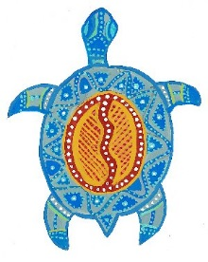
Aspects of spirituality today
Read all the quotes, reflect on what you have read
Which quote impacts on you the most?
Discuss your reasons with the group
Notes:
Art work, Australian Indigenous Images, Volume 1: Culcha Disc

Slide 24
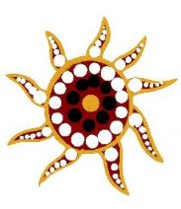
“I learned from my father one of the most precious things to live my life with. He once said to me, ‘Bubbi, just think, you come from a people that used to walk with [the] Holy Spirit across this land because this is His country and we Aboriginal and Torres Strait Islander people are His children. That is why our lands own us and give us our spiritual connections. Our Creation Beings walked with Him and with our ancestors for thousands of years.’
Cheri Yavu-Kama-Harathunian, Coordinator Nulloo Yumbah Learning Spirituality and Research Centre at CQ University
Notes:
Cheri Yavu-Kama-Harathunian, Coordinator Nulloo Yumbah Learning Spirituality and Research Centre at CQ University.
'Are we becoming are [sic] own oppressors', LinkedIn, Australian Aboriginal Network 23/9/2011
Art work, Australian Indigenous Images, Volume 1: Culcha Disc

Slide 25
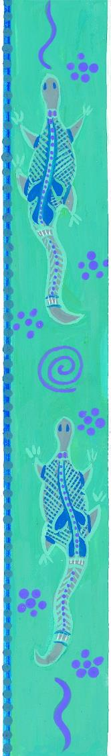
“Spirituality, in the past and in the present, permeates all aspects of Aboriginal life.
The roots of contemporary Aboriginal spirituality lie in a variety of traditions and experiences. First and foremost are the various stories, ceremonies, values and structures which sustained Aboriginal peoples throughout their long period of relatively unchallenged occupation of the continent.”
Penny Tripcony, Manager, Oodgeroo Unit, Queensland University of Technology
Notes:
P. Tripcony, ‘Too obvious to see: Aboriginal spirituality and cosmology’, Oodgeroo Unit, Queensland University of Technology, can be accessed at www.oodgeroo.qut.edu.au/academic_resources/academicpape/tooobviousto.jsp
A paper has also been written and can be accessed at:
http://www.qcaa.qld.edu.au/downloads/approach/indigenous_read001_0708.pdf
Art work, Australian Indigenous Images, Volume 1: Culcha Disc

Slide 26
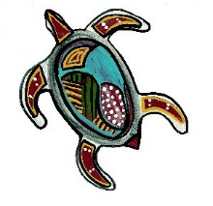
“Land was and is central to spiritual/religious life, as is clearly demonstrated within the concept of The Dreaming. This concept encompasses Aboriginal spirituality by which all components of the Australian landscape is significant, and through which the spiritual and political identities of groups and individuals are formed. The Dreaming is most readily described as: the organizing logic of so much of the symbolism of Aboriginal life and art.”
Penny Tripcony
Notes:
P. Tripcony, ‘Too obvious to see: Aboriginal spirituality and cosmology’, Oodgeroo Unit, Queensland University of Technology, can be accessed at www.oodgeroo.qut.edu.au/academic_resources/academicpape/tooobviousto.jsp
A paper has also been written and can be accessed at:
http://www.qcaa.qld.edu.au/downloads/approach/indigenous_read001_0708.pdf
Art work, Australian Indigenous Images, Volume 1: Culcha Disc

Slide 27
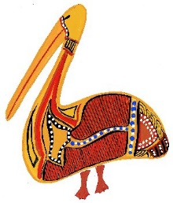
“When white people first came to Australia they saw no trace of religion in Aboriginal culture. But for Aboriginal people, their Dreaming offers far more than just religion, it is an all-encompassing spirituality determining any aspects of daily life.”
Paul Collins, Sunday Spectrum
Notes:
Paul Collins, Sunday Spectrum, ABC Television
Art work, Australian Indigenous Images, Volume 1: Culcha Disc

Slide 28
“My mother said they close their eyes in church, they go in there and talk to Spirit; this one they call God, must be the same one belong you and me; and they started to work out their Spirituality there; it’s a bit different and she couldn’t understand why they made a grand building especially to go to on Sunday to talk to this Spirit, and every other day of the week they could do what they wanted to. And she said, poor silly buggers, they make a house to go in and talk; he’s not going to lock up there, he’s everywhere; he’s in the bush he’s where we’re fishing, he’s where we’re hunting; every second of the day we’re answerable to that Spirit.”
Mrs Wadjuelarbinna, Elder Doomadgee for North Queensland, A.B.C. Radio 1999
Notes:
Art work, Australian Indigenous Images, Volume 1: Culcha Disc

Slide 29

“When we first came here we thought we had found the only people in the world without a religion. Now we have learnt that they are among the most religious people in the world.”
Pastor Albrecht of Hermannsburg mission 1926
Notes:
file:///C:/Users/WaCaReid/Downloads/4th%20July%20Newsletter.pdf
Art work, Australian Indigenous Images, Volume 1: Culcha Disc

Slide 30
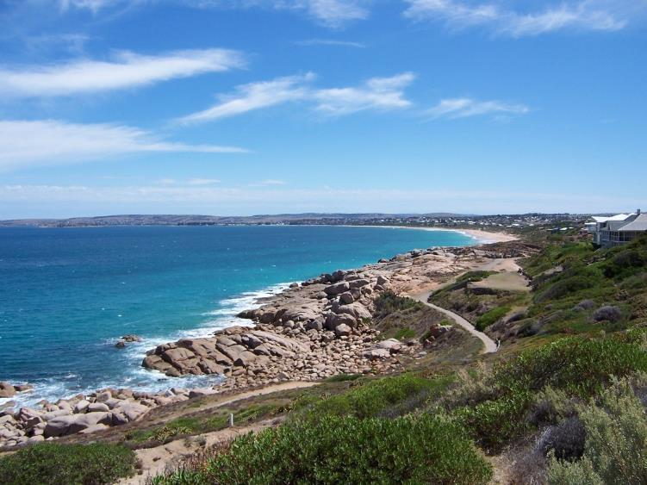
“The land owns you and you have to look after it. And that just goes on for generations. It’s passed on. And it’s in your heart. It’s in every Aboriginal person’s heart.”
Mary Darkie, Lore of the Lands
Notes:
Lore of the Lands: reconciling spirit and place in Australia’s story, Fraynework Australia, 1999.
Photograph: copyright Christine Reid

Slide 31

“Our people are very religious people – very spiritual people and for myself I believe that going into a mission and learning about the Christian way of life held no conflict. It was a continuation of what was already here – of appreciating the land and walking on it.”
Muriel Olsson
Copyright Christine Reid
Notes:
Olsson, Muriel, 1990, From the Heart.
Art work, Australian Indigenous Images, Volume 1: Culcha Disc

Slide 32
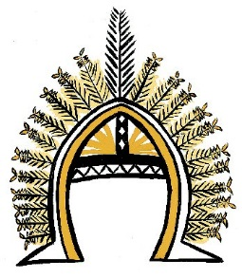
“I’m as much a Torres Strait Islander irrespective of where I live because my feelings of being a Torres Strait Islander live inside me. It is not predicated by what is outside me, it is determined with my feelings and my spirituality.”
Bilyana Blomely Academic co-ordinator, Lismore 1996
Notes:
Bilyana Blomely Academic co-ordinator, Lismore 1996
http://australianmuseum.net.au/indigenous-australia-spirituality
Art work, Australian Indigenous Images, Volume 1: Culcha Disc

Slide 33

“So the sad thing about it all was the missionaries didn’t realize that we already had something that tied in with what they’d brought to us. They saw different as inferior, and they didn’t ask us what it was that we had. And it’s very sad because if they had asked ….. things may have been different today.
Our people, before the white man came were very spiritual people. They were connected to land and creation through the great spirit, there was a great good and a great evil spirit … And Satan was the great evil one. So there wasn’t much difference in what the missionaries brought and what we already had ….” Wadjularbinna Doomadgee
Notes:
Wadjularbinna Doomadgee, Gungalidda Leader, Gulf of Carpentaria
http://australianmuseum.net.au/indigenous-australia-spirituality
Art work, Australian Indigenous Images, Volume 1: Culcha Disc

Slide 34

God has also revealed Himself to the Indigenous peoples of this land through the creation beings. We understand from Djan'kawu, Barama and Wagilag and the stories of creation that God brought forth from the earth bone/ bundurr which is sacred and blood/wukundi which is life. Accompanying these was madayin/law. By God's breath of Spirit was life given to bundurr. This is the sacredness of life and the law which accompanies it, is to ensure peace, tranquility- a harmony with all of God's creation - magayamirr dhukarr.
We are to be djungunymirr, to stop and think of the law and system, of life and it's sacredness before acting.
Statement of the Northern Regional Council Uniting Aboriginal & Islander and Christian Congress
Notes:
Statement of the Northern Regional Council Uniting Aboriginal & Islander and Christian Congress
http://uaicc.org.au/
http://www.ns.uca.org.au/wp-content/uploads/2010/05/Directory-15-22-NRCC-2012.pdf
Art work, Australian Indigenous Images, Volume 1: Culcha Disc

Slide 35
“Connectedness is important to Aboriginal culture. The identity of any Indigenous person is based on this. Aboriginal people were very close to God. Our spirits are connected to the land, and through that we are connected to the Giver of the land. God is the giver of the land. All Aboriginal people had a name for God, although we didn’t have a name for Jesus. When the name of God was mentioned, it was really special, like it was a hallowed moment.
As a young boy growing into manhood we were taught some special language. We had to learn it by heart. It was like a prayer, a bit like the Lord’s prayer. It enabled us to connect to the land, and the old people. It formed a bond.
God gave the Aboriginal peoples responsibility to look after the land they lived on – different groups had responsibility for different areas of land. The land tells a story, like where our boundaries are. We never owned the land, we had to use it and care for it, we had a responsibility not to damage it. It was like our life line when we felt a bit sick we would go back and sit down on our land and feel the warmth of belonging and we would reach out for that healing, that’s why sometimes people say our spirit, the Giver of the land. The land is crying out, damaged.”
Sealin Garlett, Chairperson of the Uniting Aboriginal and Islander Christian Congress
Notes:
Sealin Garlett, Chairperson of the Uniting Aboriginal and Islander Christian Congress.

Slide 36
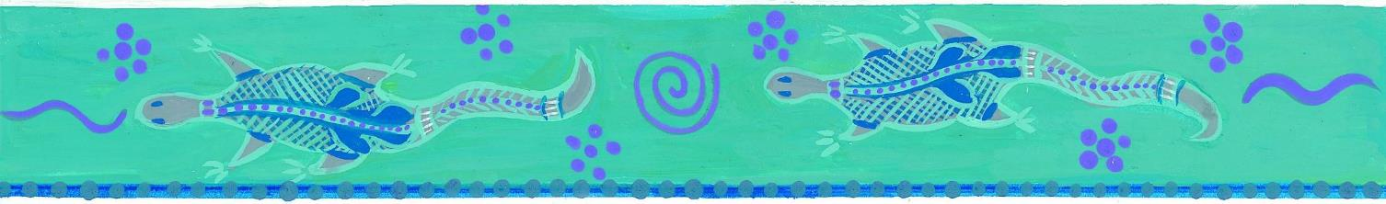
  “There is no place without a history, there is no place that has not been imaginatively grasped through song, dance and design, no place where traditional owners cannot see the imprint of sacred creation.”
  Professor Mick Dobson
Notes:
It is through Dreaming stories we are able to explain the features of our places and landscape. It is the cultural knowledge that goes with it that serve as constant reminders to us of our spiritual association with the land and its places. Even without the in-depth cultural knowledge, knowing country has spiritual origins makes it all the more significant and important to us.
My People and place. Why does place matter? Keynote address by Prof Mick Dodson, Chair of the Australian National University Institute for Indigenous Australia, at the PPP2 Conference, Sydney, April 28-29 2003.
Art work, Australian Indigenous Images, Volume 1: Culcha Disc

Slide 37

“I will continue to seek to know His will for my future. But for the present I believe I have a responsibility as a Christian and Aboriginal leader – to challenge the Christian church to show the leadership, and to be actively involved in the political and social issues as they are presented to us on a day to day basis, so we can show God’s love in our lives and to the community around us.
In traditional Aboriginal culture there was no separation made between spirituality and life. Life was the interconnection between people, and their lands and it was a spiritual relationship.
How we relate the significance of this with Christianity for me is not in doubt. I believe that Aboriginal spirituality and Christianity can work side by side.”
Dr Lowitja O’Donoghue, AC, CBE, 2000
Notes:
An address given by Dr Lowitja O'Donoghue, AC, CBE, at the Ecumenical Service, St Mary's Cathedral, Sunday, 28th May 2000.
Art work, Australian Indigenous Images, Volume 1: Culcha Disc

Slide 38
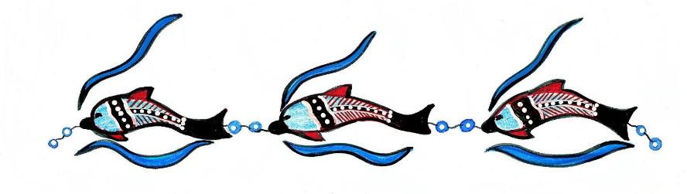
“Let me remind you that Christ died for us too, a people with a culture, language, and land.”
Dr Lowitja O’Donoghue, AC, CBE
Notes:
An address given by Dr Lowitja O'Donoghue, AC, CBE, at the Ecumenical Service, St Mary's Cathedral, Sunday, 28th May 2000.
Art work, Australian Indigenous Images, Volume 1: Culcha Disc

Slide 39
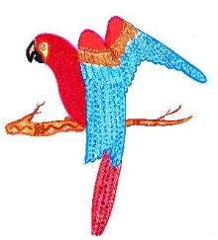
Biami the creator
“The story of Biami is a special one. Biami is a God to my people, in the beginning he stepped down from the sky and created the land, formed the mountains and valleys, filled rivers with water, and created all living things.
Everything Biami creator (sic) was wonderful! Plants of all shapes and sizes were placed on the land. He also placed men and women on special place he had created.
Biami stayed and made sure all things that he created lived together in harmony. When he was satisfied he stepped back into the sky from which he came, where he remains now watching over his people and the wonderful place he created.”
—Leslie Saxby Jupurula, Aboriginal teacher and painter
Notes:
Leslie Saxby Jupurula, an Aboriginal teacher and painter, tells a story of Biami which is surprisingly similar to the book of Genesis in the Bible:
Biami has a continuous presence in Indigenous writings from the eastern states of Australia. —Leslie Saxby Jupurula, Aboriginal teacher and painter
indidgellenium.com/Dreamtime%20Connection.html
According to Aboriginal writer Mudrooroo, Biami (or Byamee, Biame, Baiame) is an Aboriginal ‘all-father deity’ which found its way into Aboriginal spirituality as a response to Christianity. Us Mob, Mudrooroo, 1995, p.46
Art work, Australian Indigenous Images, Volume 1: Culcha Disc

Slide 40
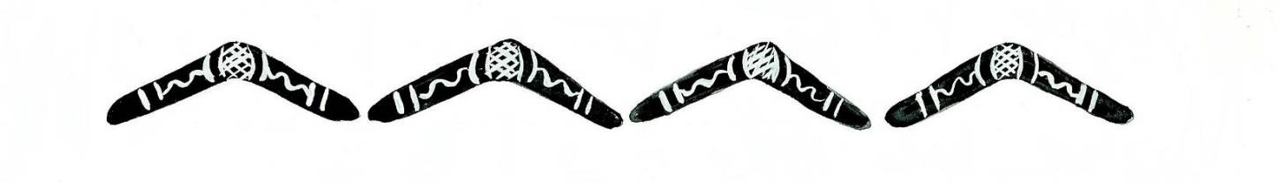
“I will not deny the strength I found through faith in God. I have met many wonderful Aboriginal Christians from all over Australia. Just because you call yourself a Christian doesn’t mean you have to deny your Aboriginality.”
Donna Meehan from her novel, It is No Secret: The story of a stolen child
Notes:
Donna Meehan, It is No Secret: The story of a stolen child, Published 2000 by Random House Australia
Art work, Australian Indigenous Images, Volume 1: Culcha Disc

Slide 41

We believe in Jesus Christ
We first heard about Jesus Christ from the missionaries. But there was already much in our culture that made it possible for us to recognise that his life and words were a true Word from God.
UNITING ABORIGINAL AND ISLANDER CHRISTIAN CONGRESS
Notes:
UNITING ABORIGINAL AND ISLANDER CHRISTIAN CONGRESS
Art work, Australian Indigenous Images, Volume 1: Culcha Disc

Slide 42
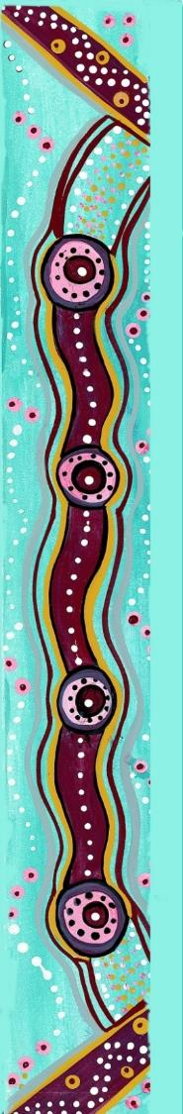
The first peoples had already encountered the Creator God before the arrival of the colonisers; the spirit was already in the land revealing God to the people through law, custom and ceremony. The same love and grace that was finally and fully revealed in Jesus Christ sustained the First Peoples and gave them particular insights into God’s ways
UNITING ABORIGINAL AND ISLANDER CHRISTIAN CONGRESS
Notes:
UNITING ABORIGINAL AND ISLANDER CHRISTIAN CONGRESS, preamble, Uniting Church in Australia Constitution.
Art work, Australian Indigenous Images, Volume 1: Culcha Disc

Slide 43
Aspects of spirituality today
Reflect on the art work
Which piece of art impacts on you the most?
Discuss your reasons with the group
Notes:
Aboriginal Christian art is a fusion of western and traditional way. Christian beliefs are combined with beliefs about the Dreaming. Aboriginal people have always had a complex spiritual life and this is used to understand and accept Christianity.

Slide 44
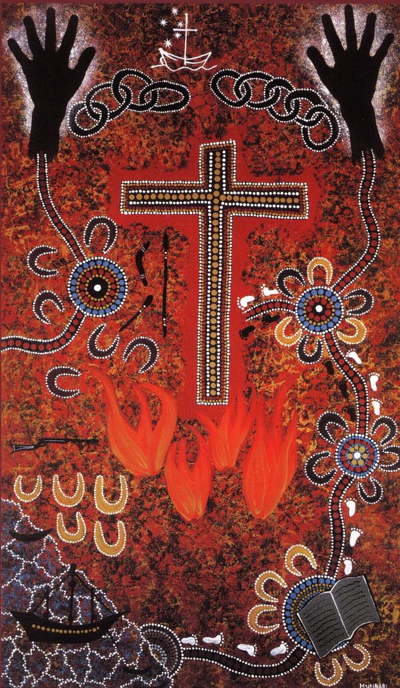
Notes:
The Painting – “Invasion”
The Artist – “Munnari” John Hammond A’Hang
The Meaning – Whiteman came to this country in their ships, with their guns. The Blackman had no answers. They were poisoned, shot, hung and put in chains as punishment.
Then along came religion, Christianity. The Bible was read at campsites by Whiteman and later black and white.
Now we walk side by side burning bridges of the past.
The chains of the past are broken, and black and white walk on equal ground through this rugged, wide land – their spirit finally freed through Christianity.
Artist Contact “Munnari” John Hammond A’Hang, c/- Kingsley A‚Hang, Justice, Freedom & Hope. Synod of South Australia, Uniting Church in Australia. P.O. Box 2145 (Second Floor, 33 Pine Street),Adelaide, S.A.5000: telephone (08) 212 4066 Produced by the Aboriginal & Islander Commission of the National Council of Churches in Australia. Painting: © 1994 by Aboriginal & Islander Commission.
Copyright: Christine Reid

Slide 45
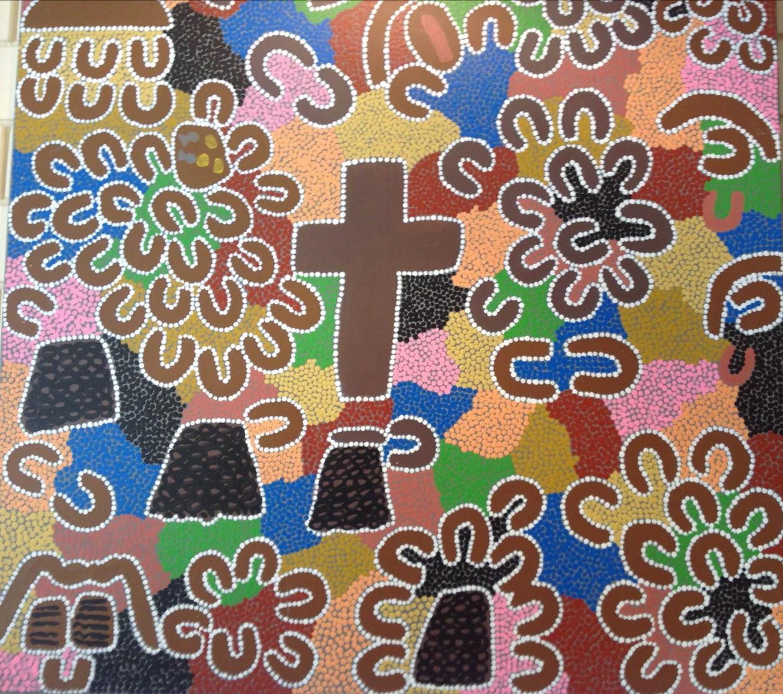
Notes:
The meaning of the painting going clockwise
Starting top left
Good Friday, 3 Wise Men, Shepherds, Jesus and children
Angels and Mary
Jesus talking to disciples Angel and Joseph
Feeding the 5000 Jesus baptism
Cain Abel
Abraham and Isaac Noah
10 Commandments Jesus healing the blind man Jesus and the 12
Painting from the Finke River Mission, artist unknown.

Slide 46
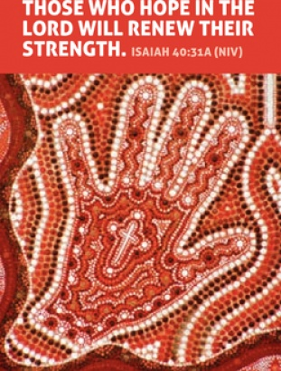
Notes:
What do you think this painting is portraying? What does the symbolism say to you?
Artist: Tricia Carter
This tract can be purchased from Lutheran Tract Mission for 10 cents. http://www.ltm.org.au/product/advanced_tract_search?q=&tag=indigenous
Copyright: Christine Reid

Slide 47
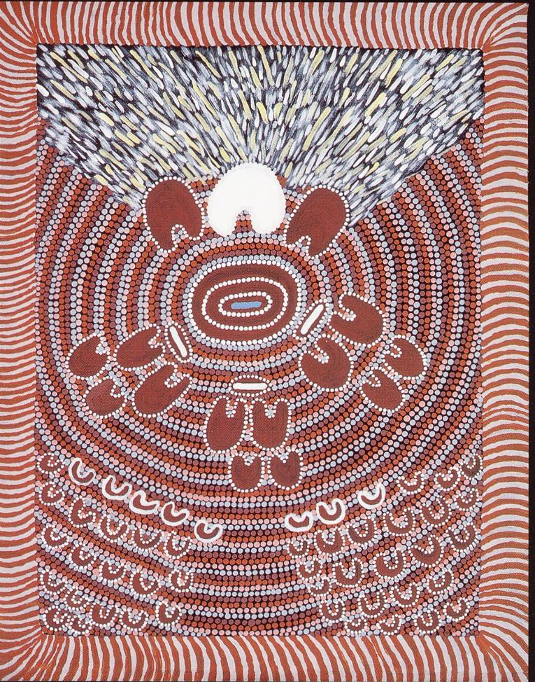
Notes:
The Baptism, artist Mary Malbunka, Haasts Bluff Mission
Baptism Day, 3 babies (small white bundles) are being brought to the waters of life (blue water in bowl). They are being supported by their 2 parents and 2 sponsors and are watched upon by their family members and the whole congregation. The pastor with the 2 evangelists on either side of him are about to perform the baptism. The pastor stands in front of the bright light of Christ which is before all the people.
This tract can be purchased from Lutheran Tract Mission for 10 cents. http://www.ltm.org.au/product/advanced_tract_search?q=&tag=indigenous
Copyright: Christine Reid

Slide 48
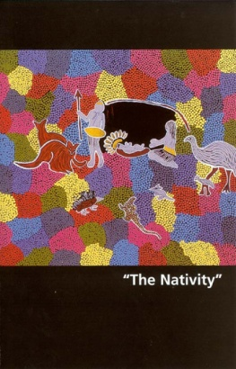
Notes:
The Nativity, artist Charlotte Phillips, Luritja
This tract can be purchased from Lutheran Tract Mission for 10 cents. http://www.ltm.org.au/product/advanced_tract_search?q=&tag=indigenous
Copyright: Christine Reid

Slide 49
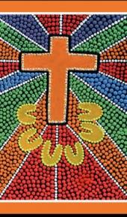
Notes:
Easter Resurrection
artist Lowina, Hermannesburg.
This tract can be purchased from Lutheran Tract Mission for 10 cents. http://www.ltm.org.au/product/advanced_tract_search?q=&tag=indigenous
Copyright: Christine Reid

Slide 50
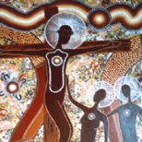
Notes:
The Catholic World Youth Day 2008 in Sydney provided another example of how traditional Aboriginal art and spirituality join modern-day spiritual beliefs.
Aboriginal artist Richard Campbell, a member of the Stolen Generations, created a series of Indigenous artworks which were used on official merchandise for the World Youth Day.
The artworks reinterpret major Catholic themes and stories from within Aboriginal spirituality, and his works Fourteen Stations of the Cross, The Madonna, The Crucifixion and The Resurrection, were used on merchandise for the 225,000 pilgrims.
The Koori Mail, online e edition, 25/11/2007, “My own spirituality came flooding back”
Richard Campbell from the Gumbaingirr/Dhungutti people recalls the moment when he realised how close Christian and Aboriginal stories can be.
“A Catholic priest once asked me to connect Aboriginal spirituality with Bible stories through a painting.
“When I started to paint, I felt my own spirituality come flooding back and I started to remember the stories of my people. That’s when I became aware of the similarity between Aboriginal and Christian stories.
“We all have a spiritual connection…, we all belong to one big God—call it Christ, we call it Birrigun, we are all one in God.”
'Spiritual art chosen for Youth Day', Koori Mail 414 p.4
More of his artwork can be found at: http://www.bing.com/images/search?q=Richard+Campbell+Aboriginal+Art&qpvt=Richard+Campbell+Aboriginal+Art&qpvt=Richard+Campbell+Aboriginal+Art&FORM=IGRE
Copyright: Christine Reid

Slide 51
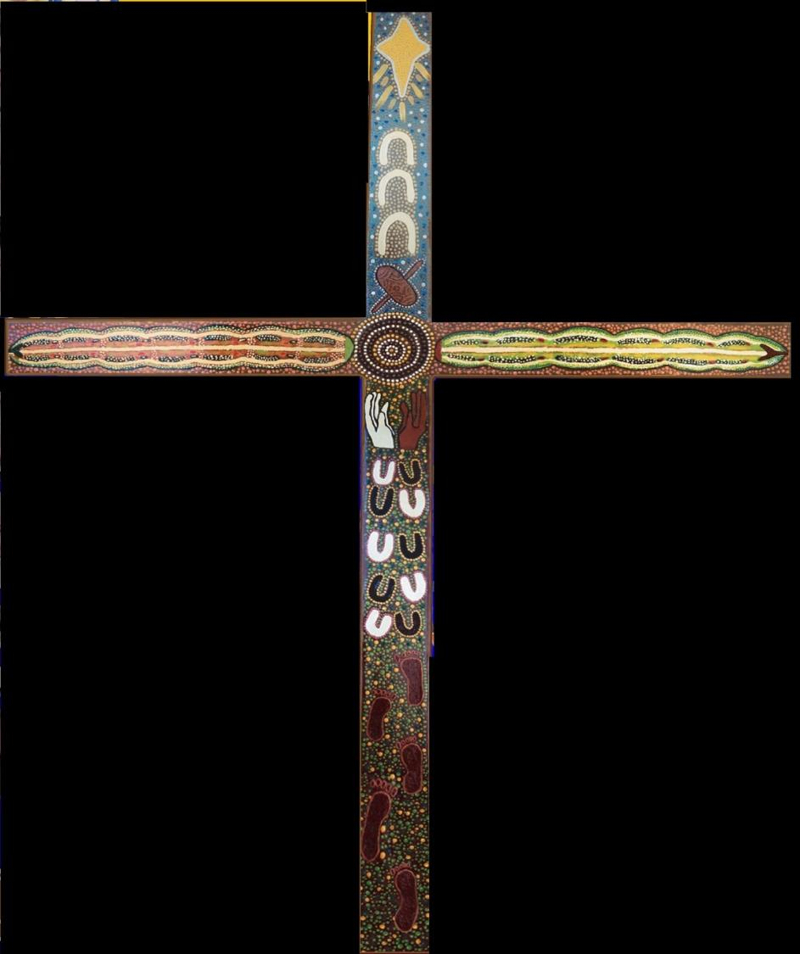
Notes:
This cross hangs on the wall at Living Waters Lutheran School, Alice Springs, NT. The art work was produced by the Arrernte women. Starting from the top and going down.
Nativity Star
The Trinity
Women’s bowl and digging stick
The school
Black and white teaching together
Black and white children learning in the classroom together
Aboriginal students walking to school
Going across is the Caterpillar Dreaming of the Arrernte people with the school in the centre.
Copyright: Christine Reid

Slide 52
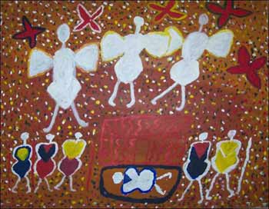
'Jesus Nativity Scene' by Mary Leahy Pumbum
Image: cooinda-gallery.com.au
Notes:
'Jesus Nativity Scene' by Mary Leahy Pumbum. Three angels hover over the shed with baby Jesus, Mary and Joseph are on the right, the three kings on the left. Image: cooinda-gallery.com.au
Copyright: Christine Reid

Slide 53
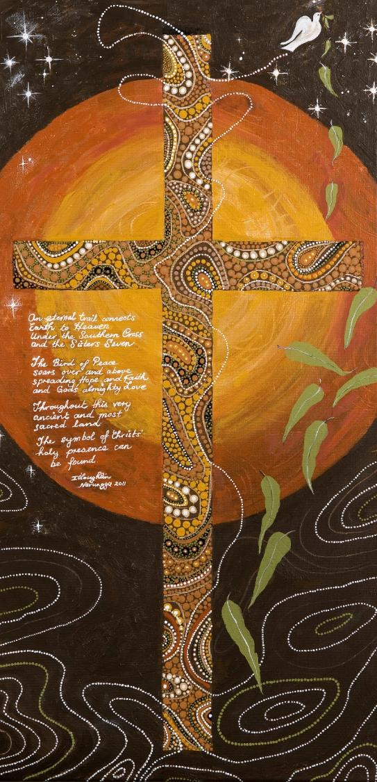
Ingrid O’Loughlin
Notes:
The words written on this art work say:
An eternal trail connects Earth to Heaven
Under the Southern Cross and the Sisters Seven
The bird of peace soars over and above
Spreading Hope and Faith and God’s almighty Love
Throughout this very ancient and most sacred land
The symbol of Christ’s holy presence can be found.
Look at the art work and find the images that match the words. Discuss this message and the images.
Ingrid O’Loughlin (grandmother of former Mount Carmel College student) is a proud Narungga woman. In 2011 she accepted a commission by the Aboriginal and Torres Strait Islander Education Team to paint a Christian cross inspired by Aboriginal art.
Ingrid used the opportunity to connect with herself and her spirituality. Anyone who has ever held a paint brush would be aware of the deep spiritual connection between an artist and canvas. The words, written on her painting, encapsulate this experience.
An eternal trail connects Earth to Heaven
Under the Southern Cross and the Sisters Seven
The bird of peace soars over and above
Spreading Hope and Faith and God’s almighty Love
Throughout this very ancient and most sacred land
The symbol of Christ’s holy presence can be found.
If your school community is interested in using this image, a royalty payment of $100 is required. Schools will be invoiced $100 and the full amount will be forwarded to Ingrid. Contact DR ROMA ALOISI, SENIOR EDUCATION ADVISER, ABORIGINAL AND TORRES STRAIT ISLANDER through Catholic Education Centre 116 George Street Thebarton SA 5031 PO Box 179 Torrensville Plaza South Australia 5031 Telephone: (08) 8301 6600.
Art work copyright Ingrid O’Loughlin.
Copyright: Christine Reid

Slide 54
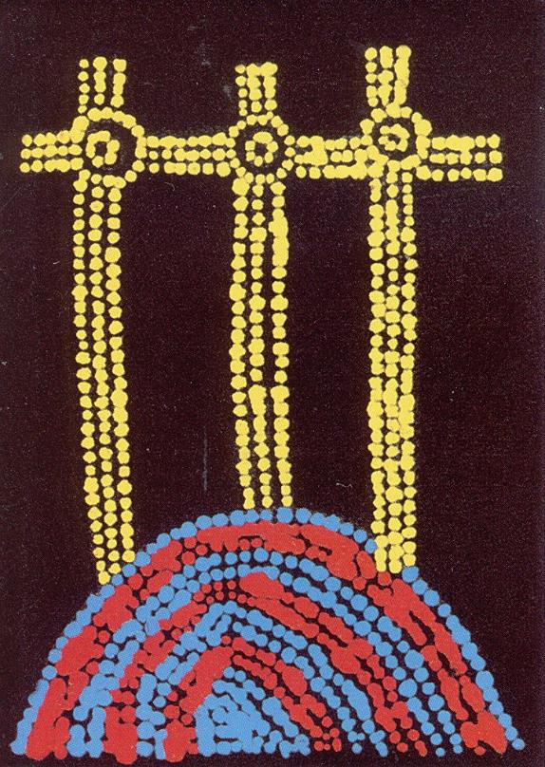
Notes:
The crucifixtion
This tract can be purchased from Lutheran Tract Mission for 10 cents. http://www.ltm.org.au/product/advanced_tract_search?q=&tag=indigenous
Copyright: Christine Reid

Slide 55
Additional sites to find Aboriginal Christian Artwork
Aboriginal Christian Painting of the Trinity and the People of God:
"Wapirra Trinity" by Clarise Nampijinpa
Poulsonhttp://mattstone.blogs.com/christian/2014/03/aboriginal-christian-painting-of-the-trinity-and-the-people-of-god.html
http://mattstone.blogs.com/photos/aboriginal_christian_art/index.html
Celebrating faith through Indigenous art: http://www.biblesociety.org.au/news/celebrating-faith-through-indigenous-art
http://www.bing.com/images/search?q=Aboriginal+Christian+art&qpvt=Aboriginal+Christian+art&qpvt=Aboriginal+Christian+art&FORM=IGRE
Notes:
These sites have a large amount of Christian art work painted by Aboriginal people.
Find paintings that can be shown to your class, talk about the traditional art style and the way the images represent Christian messages.
Some questions to ask:
What Christian elements stand out in the paintings shown?
What enables Indigenous artists to create paintings with Christian themes when originally art was also connected to a person’s own country?
Why do you think Indigenous people are able to become involved with Christianity after many negative experiences with missionaries and ‘Christian’ Westerners?
Copyright: Christine Reid

Slide 56
Redfern prayer
Pastor Ray Minniecon wrote a prayer in 2009 which became known as the ‘Redfern Prayer’.
Notes:
Read the prayer, discuss the many messages of this prayer. What can we do to make a difference in the lives of Indigenous people today?
Redfern Prayer
God of our Dreaming. Father our all Aboriginal nations in Australia. You have lived among us since time immemorial. We have always known You. You gave this land to our Aboriginal nations. You have not dispossessed us nor destroyed us.
People from other lands, who do not understand our unique culture, our unique lifestyle and our unique heritage have come and destroyed much of our way of life. Many of these people from other lands now want to understand and reconcile with us.
But for many of us Aboriginal people, we find this reconciliation business a little difficult.
Too many of our children are still in jails.
Too many of our children are still living in sub-standard housing.
Too many of our mothers are living on the streets or in refuges.
Too many of our children are still uneducated.
Too many of our children have no land and no community to go back to.
Too many of our children have not got good opportunities for good employment.
Too many of our children are living in extremely unhealthy environments.
Too many of our children are living among violence and abuse.
Too many of our children are dying to drugs and other soul-destroying substances.
God our Dreaming and Creator of our people, we sometimes feel overwhelmed by these things. Many of us feel like we are refugees in our own land.
Today we are coming together again on one of our battlegrounds to cry out to You for mercy and justice for our children, for our families and for our land.
We pray that more resources will be given to our local community organizations to help us grow healthy and strong.
We pray that the peoples from other lands will be given a heart of flesh instead of a heart of stone so that they can understand us and support us properly.
We pray that your Spirit will help and encourage us to grow good strong Aboriginal leaders.
Father we want to grow strong and healthy again in our own land. We want to take our rightful place in our land and make our contribution to the re-building of our families, our communities and our nation.
Please hear our cries for justice. We ask these mercies in the name of Your Son.
Amen.
www.CreativeSpirits.info, Aboriginal culture - Spirituality - Redfern prayer, retrieved 9 April 2015
Copyright: Christine Reid

Slide 57
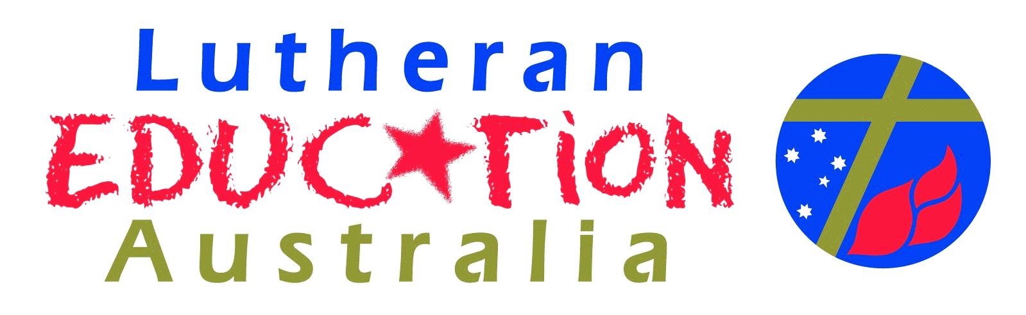
Christian Studies Program
What do you need to do?
Gain an understanding of Indigenous culture
Reading
Professional Development
Visit museums
Art Galleries
Music
Poetry
Drama
Read the Bible and analyse with all people in mind.
Include Indigenous perspectives in the lessons
Notes:
Copyright: Christine Reid

Slide 58
Ideas for lessons
If you have Aboriginal students in your class advise the parents of the topic and some of the information being taught, shown.
Show selections from the powerpoint on Spirituality, stop for discussion
Follow up task, Choose 3 songs, one being Indigenous that reflect Spirituality eg Yothu Yindi, Bob Randall, Geoffrey Gurrumul Yunupingu, Archie Roach, Look for the elements of Indigenous spirituality in the songs,
philosophy, religion, law, lore
country, place, home
family, kinship, systems, relationships
spirit, soul, psyche
Notes:
Ideas for lessons
Attitudes – Negative feelings, paternalism, missionaries
Christian principles – Love your neighbor; Made in the image of God.
Contemporary issues affecting Indigenous people – Land Rights, Stolen Generation, Health, Education, Racism, The Apology, Reconciliation
Contemporary Indigenous celebrations – Reconciliation Week, Sorry Day (Journey of Healing Day SA), NAIDOC Week
Social justice/Indigenous social justice heroes
Celebrations/ elements of ceremonies e.g. music, dance, symbols, food
Family
Discipleship
Christian ethics
Diversity of Indigenous cultures as an expression of God’s creative love
Indigenous Spirituality
Sacred story
Creation
Stewardship / Ecology / Sustainability
Sacred places
Sacred objects
Symbolism, ritual, colour
Seasons – compare the Liturgical year with the seasonal cycles
Indigenous guest speakers or use primary resources from DVDs, U-tube etc.
Copyright: Christine Reid

Slide 59
INDIGENOUS FOCUS RESOURCES TO SUPPORT CHRISTIAN STUDIES
Notes:
INDIGENOUS FOCUS RESOURCES TO SUPPORT CHRISTIAN STUDIES
Holy, Holy, Holy, Editor: Stephanie Radok, Publisher: Flinders University.
Holy Holy Holy focuses on the enduring influence of Christianity on Aboriginal people looking primarily at contemporary visual art.
Kanyini, Melanie Hogan and Bob Randall. Through the gentle and wise words of 'Uncle' Bob Randall, Nyuntu Ninti shows us what we should all know about an ancient and spiritual culture that is the very heart and soul of Australia. (DVD)
Nyuntu Ninti What you should know, Authors: Bob Randall and Melanie Hogan, ABC books
Through the gentle and wise words of 'Uncle' Bob Randall, Nyuntu Ninti shows us what we should all know about an ancient and spiritual culture that is the very heart and soul of Australia. (Junior Primary)
Many Voices : reflections on experiences of Indigenous child separation, edited by Doreen Mellor and Anna Haebich, National Library of Australia.
Separated children, and others directly affected by, or involved in, child removal have spoken of their experiences, contributing to a major collection comprising more than 340 digitally recorded interviews. The book Many Voices: Reflections on Experiences of Indigenous Child Separation, arising from the project, will facilitate more comprehensive access to the collection. Editors Doreen Mellor and Anna Haebich have brought together a diverse group of expert writers, whose words are interwoven with art works and poetry by Indigenous artists, many of whom are contributors to the Project. The audio CD is a compelling addition to the text. (secondary +)
Countering Racism; Department of Education Training and Employment.
This book uses a critical approach in teaching and learning contexts to explore portrayals of Aboriginality. (secondary +)
The Apology to the Stolen Generations, DVD, Reconciliation Australia. Resources can be provided free of charge by accessing the following website. (all year levels)
http://www.reconciliation.org.au/home/reconciliation-resources/apology-resources
Why Me? 5 stories of removal from family and country. DVD, Nunkkuwarrin Yunti of South Australia, 08 8223 5217. 5 stories of removal from family and country. Re-enacted scenes from the 1950s and 60s show the emotional journeys of the children of the stolen generation. (middle primary, upper primary, secondary +)
Copyright: Christine Reid

Slide 60

Copyright - Christine Reid
Christine Reid Educational Consultant
Contact details:
telephone – 0403816839
email – wacareid@tpg.com.au
www.facebook.com/ChristineReidEducationalConsultant
Notes:
If you would like support in sharing these presentations with your staff please contact Christine Reid.
Copyright: Christine Reid

