Slide 1


Slide 2
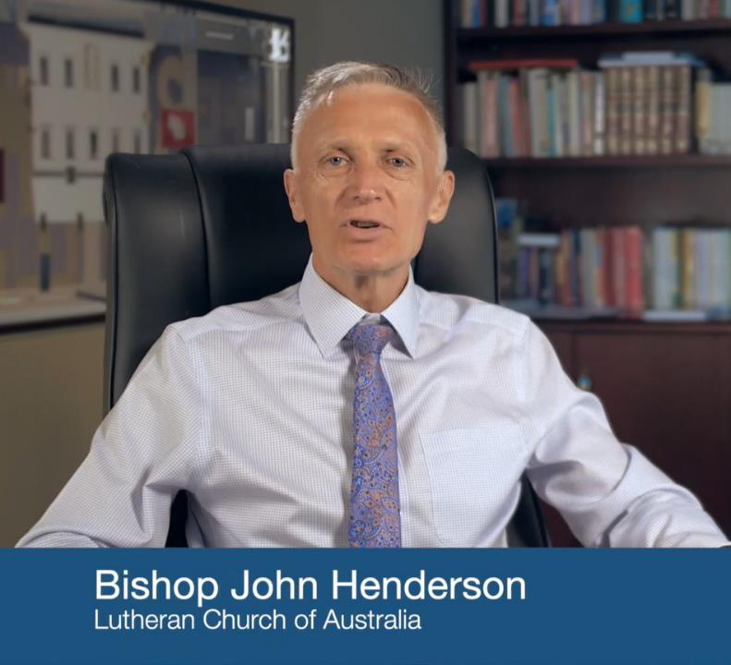
Bishop John Henderson welcome
http://fast.wistia.net/embed/iframe/vppy9cpdbu?popover=true

Slide 3


Slide 4
Please take a few minutes to say ‘Hi’ to 2-3 others in the room.
Introduce yourself and your role.
What is something you learnt or experienced this summer?
What have you found out about how you learn best?

Slide 5

Connect is the course for new staff in Lutheran education. It explores Lutheran education, its beliefs and spiritual life. It helps you inquire into ‘why we do what we do’. It will also help us to know you.
The course is designed to ‘set you up for success’ as it supports you to serve and reflect on your role and contribution to the mission of your school or ECS.

Slide 6
Vision and Purpose
World of parents and students: expectations, hopes, beliefs and
values
World of the curriculum, compliance and regulators: VCAA, ACARA, VRQA
Beliefs & Assumptions
Goals &
Outcomes
World of the teacher: identity, purpose, beliefs and values
Values

Slide 7
Connect provides a blended learning environment with face-to-face sessions supported with online engagement. The course consists of the following sessions that are equivalent to three days of learning.
• Induction (today)
• Session 1-3 ( face-to-face in-school time, approx. 3hrs each)
• Session 4 (1 day face-to-face regional delivery)

Slide 8
ePortfolio
We will be using ePortfolio to record and reflect on your learning as you journey through the next 12 months. You can choose a platform that is easy for you and you will have time in each session to record your reflections, questions and possibly the different perspectives shared in sessions.

Slide 9
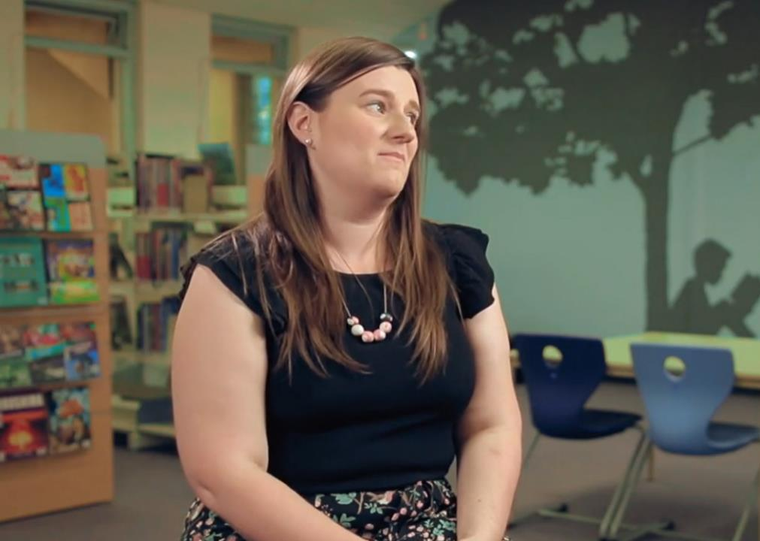
What can you expect?
http://fast.wistia.net/embed/iframe/2qhhlaessq?popover=true

Slide 10



Slide 11
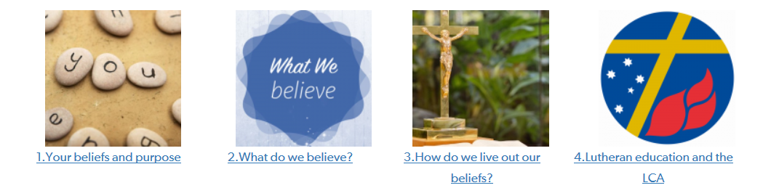
Today we will explore these 4 topics

Slide 12

Your beliefs and purpose
ePortfolio Entry #1
The beliefs, experiences and values you bring are important. We believe you have an important contribution to make to Lutheran education.
Record your thinking as you reflect on these questions:
What has brought you here to this Lutheran school?
What is important to you? What are you passionate about?
What experience/expectations do you have about working in a Lutheran school?
These initial thoughts and questions are your first entry in your ePortfolio.
Your questions will be helpful in shaping the content of the course.

Slide 13


Slide 14


Lutheran Education and the LCA
Our schools are a part of mission and ministry of the Lutheran Church of Australia (LCA). While the Lutheran church is small in Australia, it is the largest protestant church in the world.
Our College logo is based on Martin Luther’s personal crest. Our motto connects us to the central theme of the Reformation, that it is by God’s grace through Christ, that we are saved.

Slide 15

Did you know…
A giraffe can clean its own ears with its 21-inch tongue! ePortfolio Entry #2
As you watch the next 3 clips:
1. Note down a few ‘facts’ about Lutheran Schools you personally found interesting.
2. What do you wonder about?
3. What would you like to know more about?

Slide 16
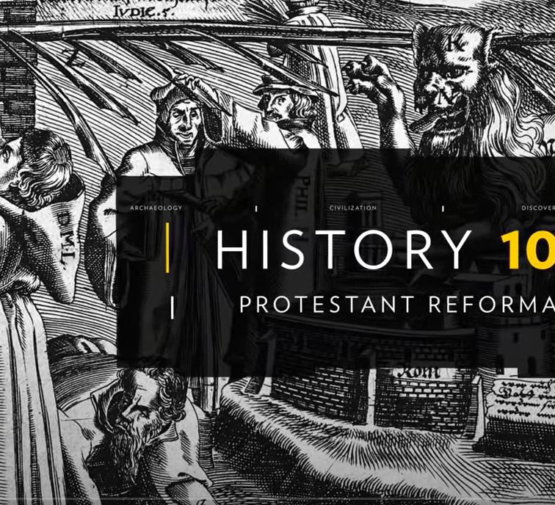
The Protestant Reformation
https://www.youtube.com/watch?v=IATyzSAjC1w

Slide 17
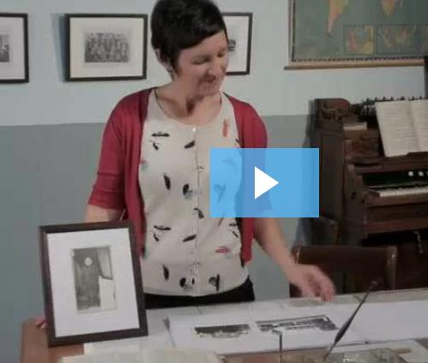
Lutheran schools: a rich history
http://www.lutheran.edu.au/school-professionals-2/governance/an-overview-for-governing-bodies/lutheran-schools-a-rich-history/

Slide 18
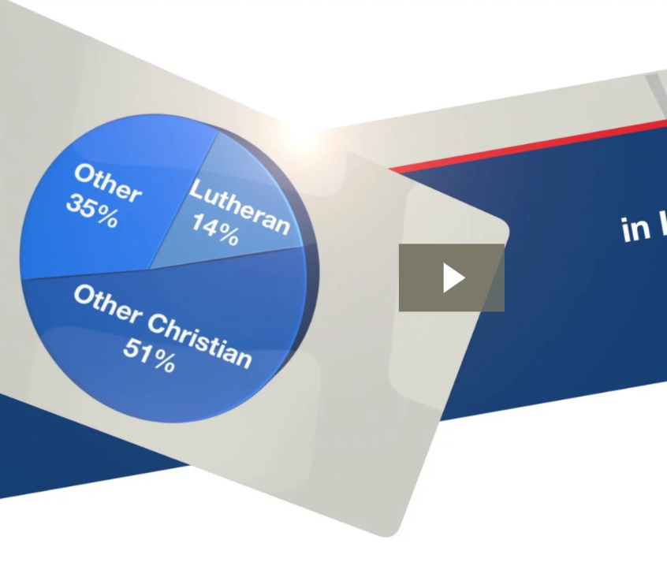
Lutheran schools by numbers
http://fast.wistia.net/embed/iframe/tnfv7akxop?popover=true

Slide 19
Did you know…
A giraffe can clean its own ears with its 21-inch tongue! ePortfolio Entry #2
As you watch the next 2 clips:
1. Note down a few ‘facts’ about Lutheran Schools you personally found interesting.
2. What do you wonder about?
3. What would you like to know more about?

Slide 20

What do we believe?
What is important in Lutheran education? How does Lutheran education describe itself? As a school of the Church, our work is grounded in God’s love for all in Christ.
The Lutheran Church of Australia through its congregations and districts, owns and operates kindergartens, primary schools, and secondary schools. It does this in order to make available to its members and to others in the community a formal education in which the gospel of Jesus Christ informs all learning and teaching, all human relationships, and all activities in the school.

Slide 21
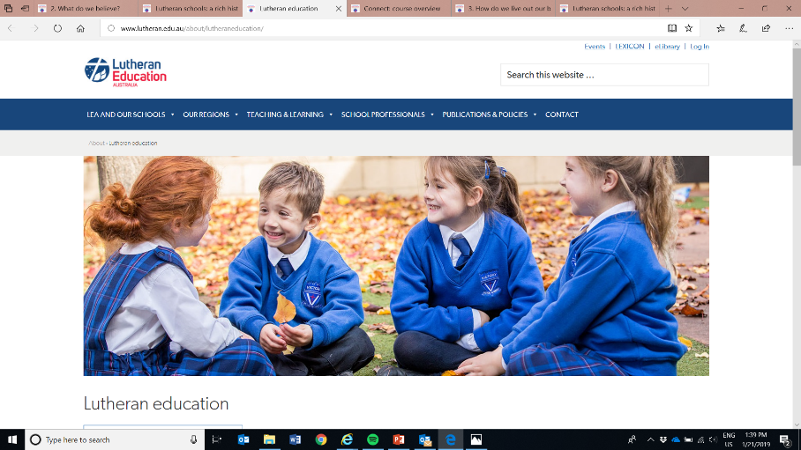
The LEA website contains the key policies and statements that describe our values and philosophy

Slide 22
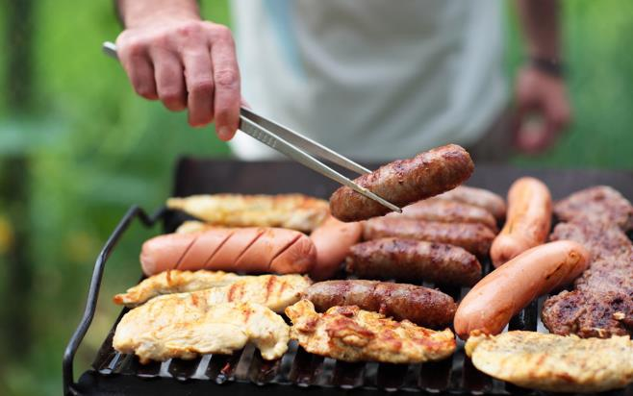


What are the key values and principles that guide our learning and living as
Lutheran Schools?
ePortfolio Entry #3
Use the brochure; ‘What is so special about a Lutheran School?’ and the College website to formulate the BBQ chat…
you know, when someone asks you where you work, and you say ‘GLC’, and they say; ‘So what’s that?’, and you say…

Slide 23
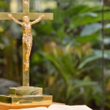
How do we live out our beliefs?
How does Lutheran education live out its spirituality?
Lutheran schools and early childhood services provide a range of opportunities for all staff and students to be engaged in learning about, and experiencing, Christian spirituality.
It is our prayer that staff and students will find these opportunities and experiences helpful in their personal spiritual journey.

Slide 24
How do we live out our beliefs?
How does Lutheran education live out its spirituality?
Staff and students experience Christian spirituality through practices such as whole school worship, staff devotions, class or pastoral care group devotions and staff retreats.
Staff have the opportunity to learn about Christian spirituality through courses such as Connect and Equip and ongoing formation opportunities provided by the school.
Students learn about Christian spirituality through their learning, experiences and relationships in the school or ECS and specifically in the key learning area, Christian Studies.

Slide 25


Every morning we commence our staff briefing with a 5 min devotion led by staff. We have a few resources/books you are most welcome to use or feel free to develop your own thoughts.
Students have Chapel in sub-school groups on Wed/Thurs (AC) and on Wed/Fri at StJ. Classroom devotions also occur in HG time led by the teacher. Combined chapels take place on special occasions.

Slide 26
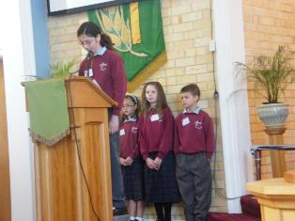
School worship
No presupposition of a participant’s faith
No presupposition of baptism
No presupposition of involvement in congregational worship practices
No presupposition of biblical literacy
Compulsory attendance

Slide 27
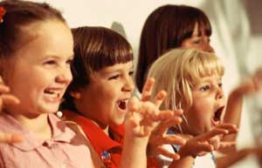
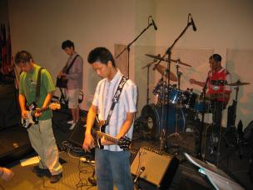
Appropriate Elements for School Worship
Bible reading
Telling Bible stories
Prayers of request and thanks –
for students, school and the world
Blessing
Singing
Group silence for meditation and contemplation
Appropriate ritual acts (eg candles, signing of the cross for blessing etc)

Slide 28


Slide 29
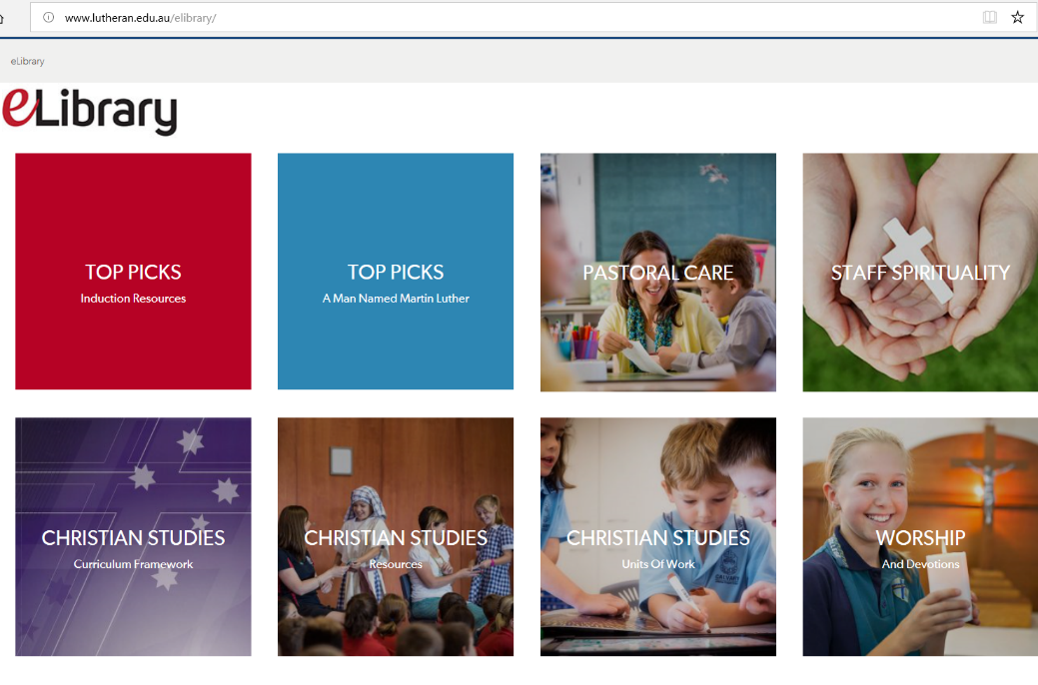

Slide 30
Before next time:
Please take some time to click around the Lutheran Education Australia site
http://www.lutheran.edu.au/
You may also want to have a look at the resources available on the elibrary
http://www.lutheran.edu.au/elibrary/
I will fwd links to these sites. Feel free to raise any questions/queries that arise.

