Slide 1
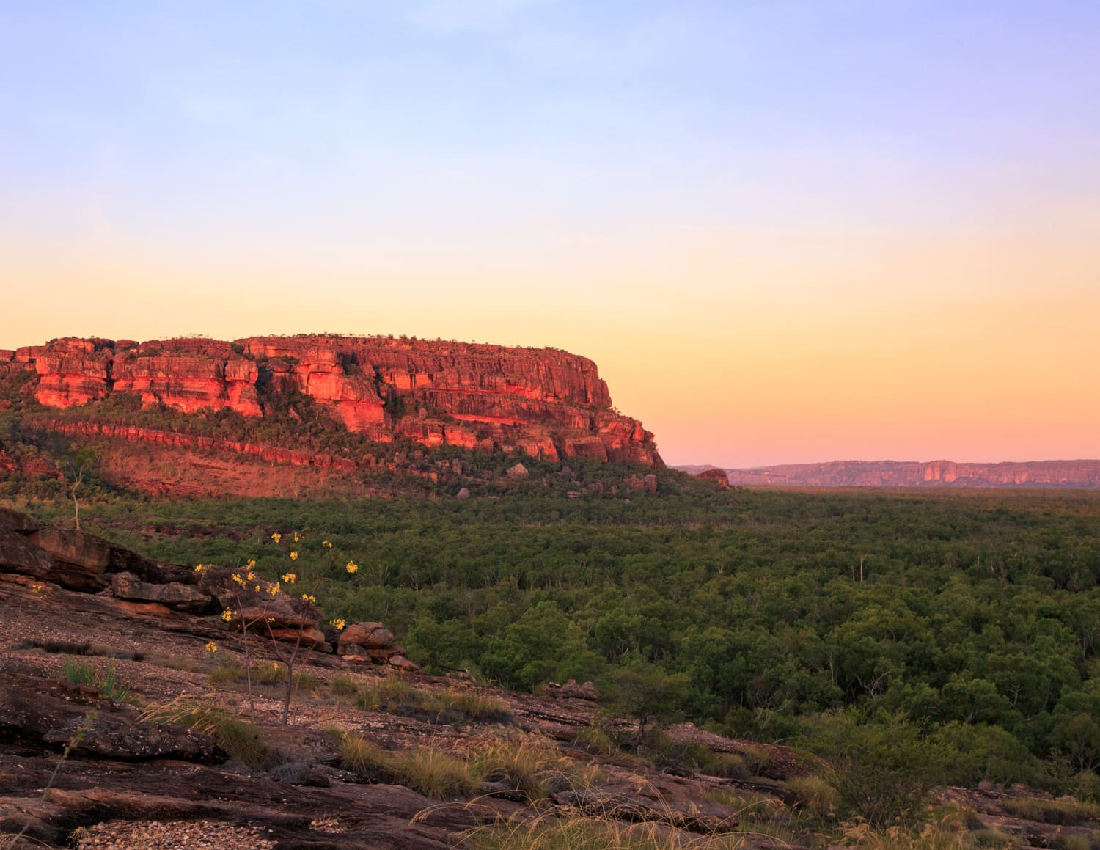
NAIDOC week
Always was, always will be
Notes:
NAIDOC Week celebrations are held across Australia each July to celebrate the history, culture and achievements of Aboriginal and Torres Strait Islander peoples. NAIDOC is celebrated not only in Indigenous communities, but by Australians from all walks of life. The week is a great opportunity to participate in a range of activities and to support your local Aboriginal and Torres Strait Islander community.

Slide 2
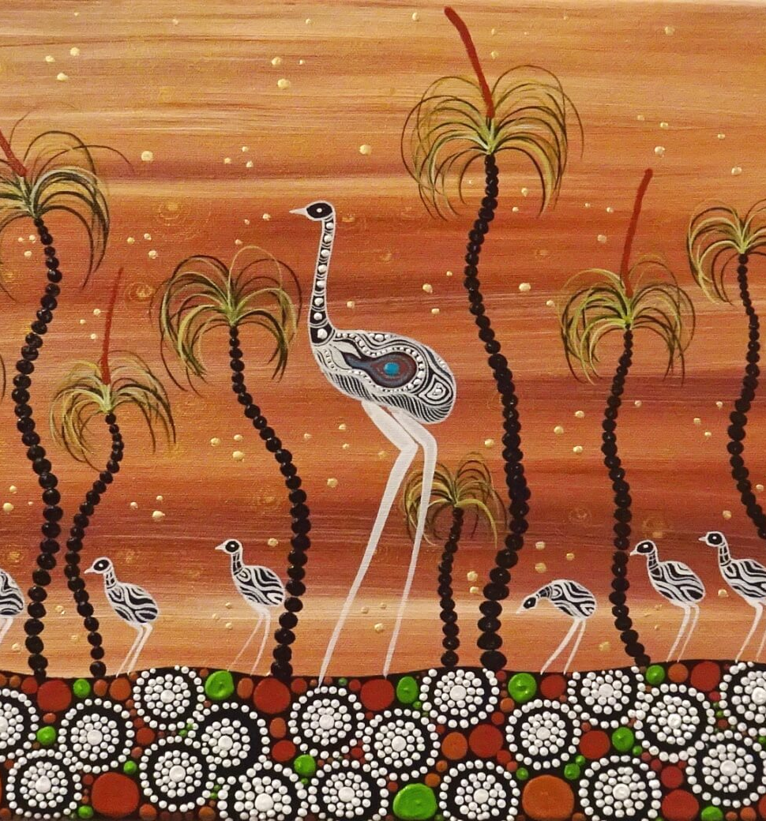
Psalm 23 – Aboriginal Style by Uncle Rev Ron Williams
My big fella boss up in the sky is like the father Emu.
He will always look after me and take me to green grass,
and lead me to where the water holes are
full and fresh all the time.
He leads me away from the thick scrub and helps me
keep safe from the hunters, dingoes and eagles.
At nighttime when I am very lonely and sad,
I will not be afraid,
for my Father covers me with his feathers
like a father emu.
His spear and shield will always protect me.
My big fella boss always give me a good feed
in the middle of my enemies.
In hot times he makes me sit down in a cool shade and rest.
He gives me plenty of love and care all of my life through.
Then I will live with my big fella boss like a father emu:
that cares for his chicks in good country, full of peace and safety
For evermore and evermore.

Slide 3
Amazing grace

Slide 4
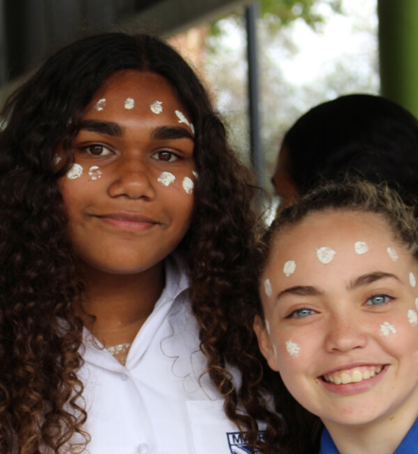
Benediction Prayer
By Francis Bodkin of the Bodkin-Andrews clan of the D’harawal Peoples
May you always see the beauty of the Earth May you always taste the sweetest fruit May you always hear the laughter of the People May you always feel the warmth of the Flame May you always smell the perfume of the flowers May your dreams always be happy ones May your friends always be with you when you have need May your stomach always be full May you never feel hurt

